Slide 1
Auditrunner Solution Approach
Audit, Risk, Compliance & Quality Management Software

Slide 2
Communication
Approach
Continuous feedback & Solid progress
Business perspective
Short development cycles and frequent feedback to deliver continuous and solid progress without months-long schedules.
Clearly understand and guide business units.
360° analysis of your business
Save time and money
Improvements & Updates
Collaboration with not just IT departments but with business owners.
Low-code application platform enables delivery of adaptations and new developments, 3x-4x faster than conventional environments.
Continuous upgrades and updates based on user feedback, to keep applications always aligned with ever-changing business needs.

Slide 3
Low-code Application Environment
Flexible
Easily modify all master data such as organizational structure and hierarchy, and drop-down options on screens using configuration options.
Customizable
Every component of all applications (mechanics, screen designs, dashboards etc.) can be changed to accommodate special requests, three-to-four times faster than conventional environments.
Collaboration
Bring together all departments, auditors and audited departments alike. Different regional offices, entities and subsidiaries can be brought together in a multi-language environment.
Scalable
Scale-up, down or across among modules and user basis as needed. Since all units submit their data through the system, all data is accumulated and can be used by all modules.
Integration
Integrate with any third-party system for two-way data stream and automation scenarios.
No installation
End users can access the same content and function using any kind of device, without any installation.

Slide 4
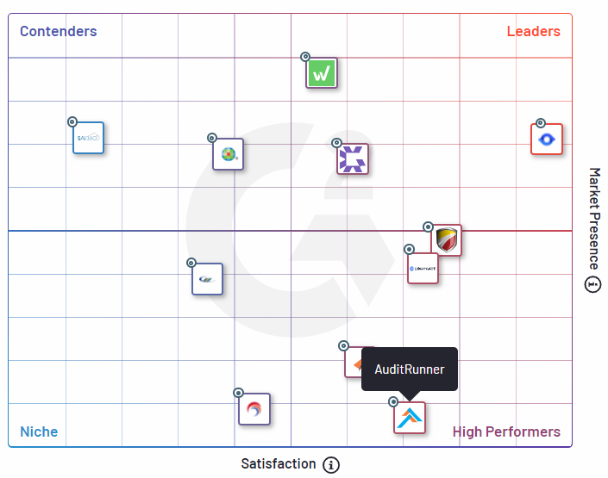
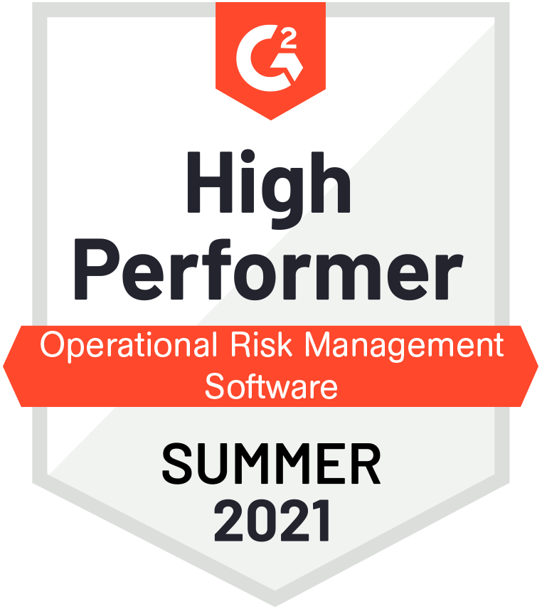
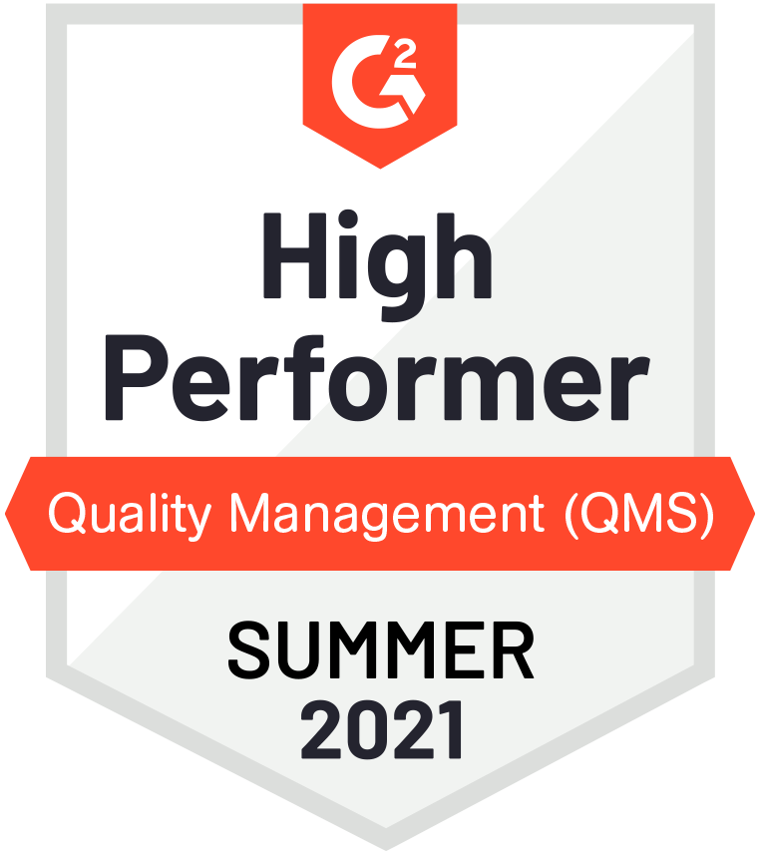
According to G2 reviews
You are in
good company
AuditRunner is ranked as a High Performer in Audit Management, Operational Risk Management, and Quality Management software categories.
G2 Grid® for Audit Management Software
Read more about this

Slide 5
Typical Work Chart for On-premise Setup
Auditrunner Core platform installation & configuration
3 man-days
Installation & initial configuration of selected modules
4 man-days
HR Software & Authentication (LDAP/OAuth) integration
4 man-days
Extra integrations (per integration interface)
3 man-days/service
Customizations & extra development (3x-4x faster than traditional environments)
Depends on scope
*Given timeline is based on the assumption that all items of Client data, components of Client infrastructure and integration interfaces are adequately prepared and ready for use.

Slide 6
Typical Work Chart for Cloud (SaaS) Setup
Auditrunner Cloud tenant provisioning & initial configuration
2 man-days
Installation & initial configuration of selected modules
4 man-days
HR Software & Authentication (LDAP/OAuth) integration
4 man-days
Extra integrations (per integration interface)
3 man-days/service
Customizations & extra development (3x-4x faster than traditional environments)
Depends on scope
*Given timeline is based on the assumption that all items of Client data and integration interfaces are adequately prepared and ready for use.

Slide 7
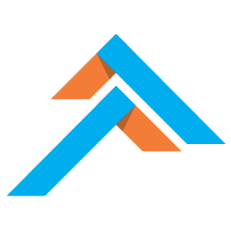
Get in
touch
Contact Information
4048 Lick Mill Blvd, Santa Clara, CA
Auditrunner
+1 650 206 2368
sales@auditrunner.com
The Low-code Audit, Risk, Compliance & Quality
Management Software
www.auditrunner.com
Visit Us

