Slide 1
Low-code GRC Solution
Applications for Financial Services Companies

Slide 2













Complete GRC Management
Collaboration between Governance, Risk & Compliance teams
Internal Audit
Risk & Controls
Quality Assurance
Compliance
Administer all your internal audit
activities in line with IIA instructions
Build up your company-wide risk inventory
and control environment
Establish standard accreditations and
execute specialized activities
Ensure compliance with legislations and
collect all data in a single system
Risk-oriented Planned &
Ad-hoc Process Audits
Ethical Breach Reporting
Investigations
Branch Audits
Operational/Enterprise Risk & Opportunity Management
Business & Client Risk Assessment
Internal Controls
Control Effectiveness Tests
Standards Compliance Audits
Document Management
Corrective Actions ISO9001
Information Security ISO27001
Business Continuity ISO22301
Regulatory Compliance Audits
Liabilities & Responsibilities
Data Protection Governance
Sanctions Compliance
SOX Compliance

Slide 3







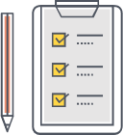
Complete Internal Systems
Collaboration throughout your organization with centralized common content
Process Catalog
Action Follow-up
Document Editor
Meeting Manager
Compile business processes associated with
documents and flowcharts
Track the progress of action plans for findings, risk mitigation and other activities
Create, manage, revise and publish all internal documentation
Organize and execute meetings, create meeting minutes and assign action plans
Standards & Regulations Catalog
BPM Modelling
Document Manager
e-Training & e-Survey
Model flow charts of processes with BPMN2 notation, create RACI and SIPOC matrices
Digitalize & archive
all printed documents,
create automation scenarios
Create and distribute training material, tests and surveys. Evaluate results and issue certificates.
Compile governing regulations and standards associated with documents and literature

Slide 4
Low-code Application Environment
Configurable
Easily modify all master data such as
organizational structure and hierarchy,
and drop-down options on screens
using configuration options.
Customizable
Every component of every application
(mechanics, screen designs, dashboards etc.)
can be changed to fit special requests,
3x-4x times faster than conventional environments.
Collaboration
Bring together all departments, auditors and audited departments alike.
Different regional offices, entities and subsidiaries can be brought together
in a multi-language environment.
Scalable
Scale-up, down or across among modules and user basis as needed.
Since all units submit their data through the system, all data is accumulated and can be used by all modules.
Integration
Integrate with any third-party system for two-way data stream and
automation scenarios.
No installation
End users can access the same content and function using any kind of device, without any installation.

Slide 5
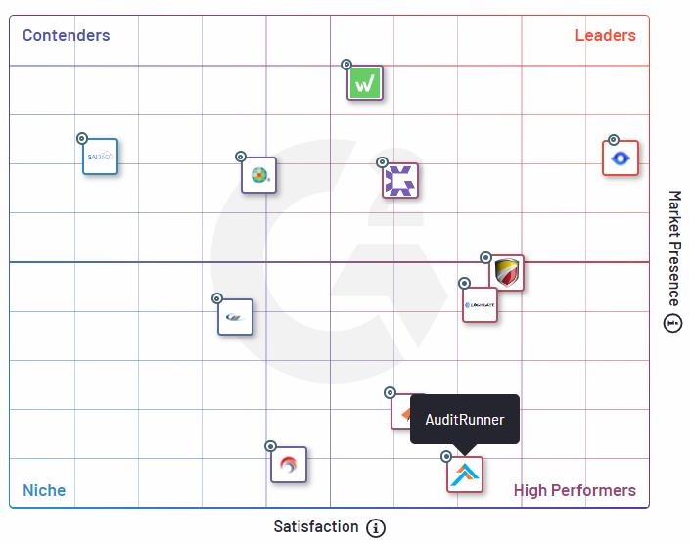
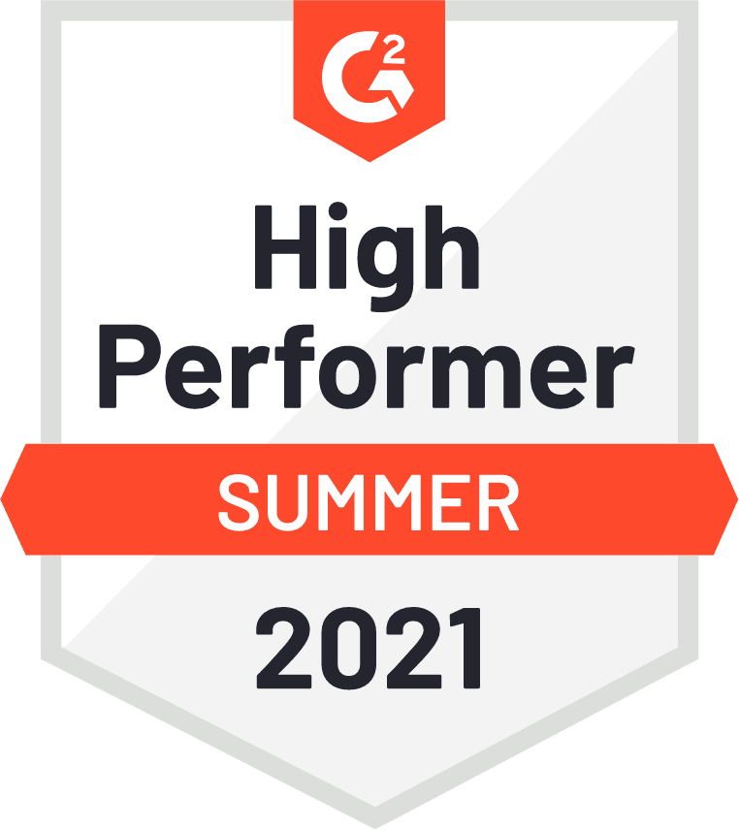
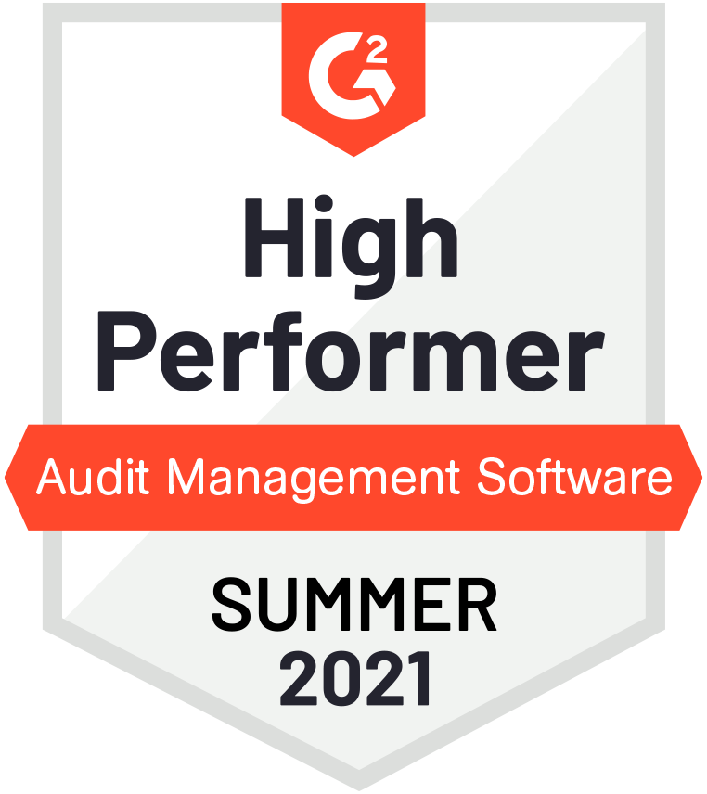
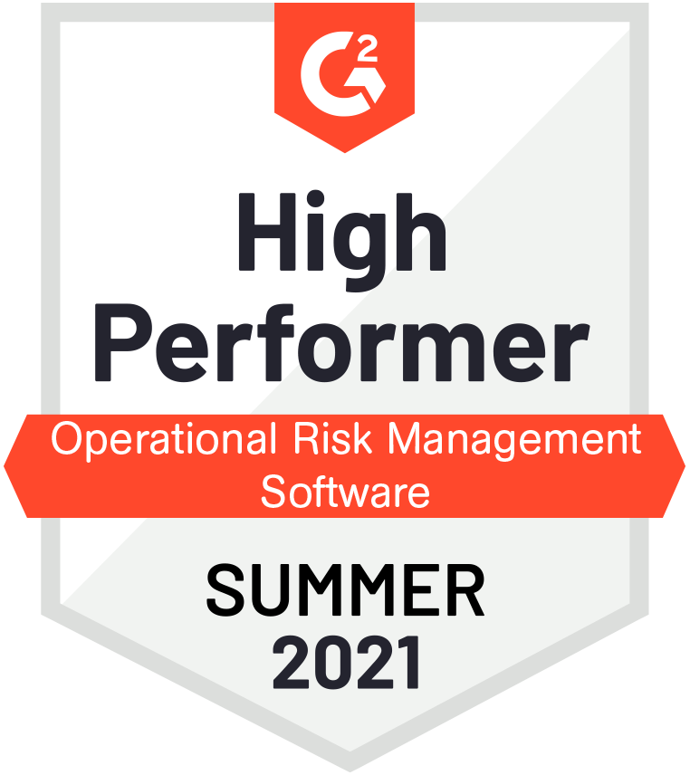
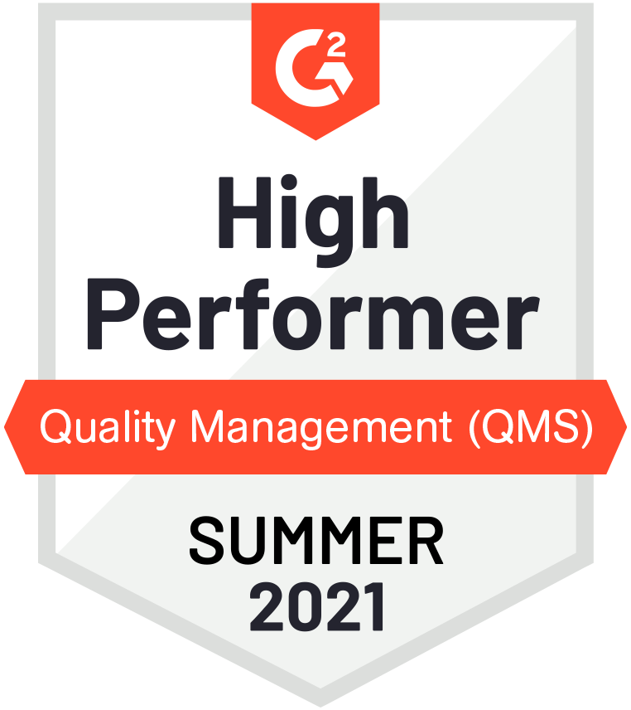
According to G2 reviews
You are in
good company
AuditRunner is ranked as a High Performer
in Audit Management, Operational Risk Management, and Quality Management software categories.
G2 Grid® for Audit Management Software
Read more about this

Slide 6
Integrated Governance
Auditrunner’s Two-Pillar Approach
Internal Audit
Quality
Assurance
Internal
Processes
Standards
&
Regulations
Control
Environment
Risk
Management
Information
Security
Compliance
Process-based Governance
Criteria-based Governance

Slide 7
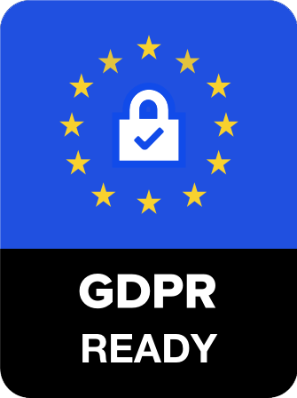
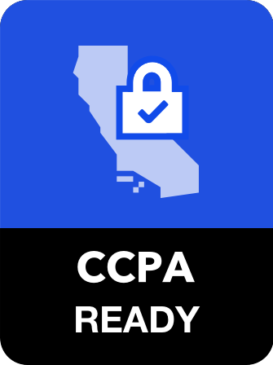
Data Protection Compliance Suite
Establish compliance with data protection regulations
Incident
Mgmt
Regulation
Catalog
Information
Assets
Data Inventory
Request
Mgmt
Data
Destruction
Process Catalog

Slide 8
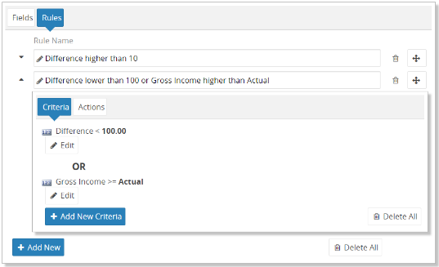
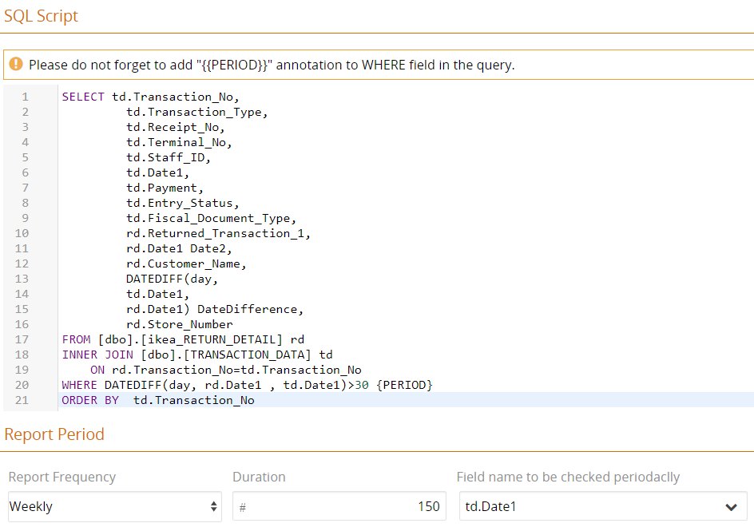
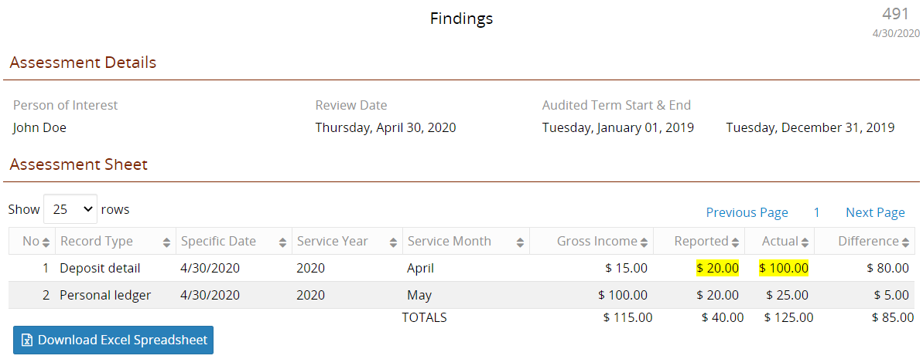
Query
Engine
Auditrunner Query Engine can automatically filter and highlight findings, nonconformities, potential frauds, risks and outliers
on sampled or complete data set.
Query Engine can work on millions of rows of data and check against dynamically set logical rules and database scripts.
You can create scenarios to be automatically executed when certain criteria is met for each rule and script .

Slide 9
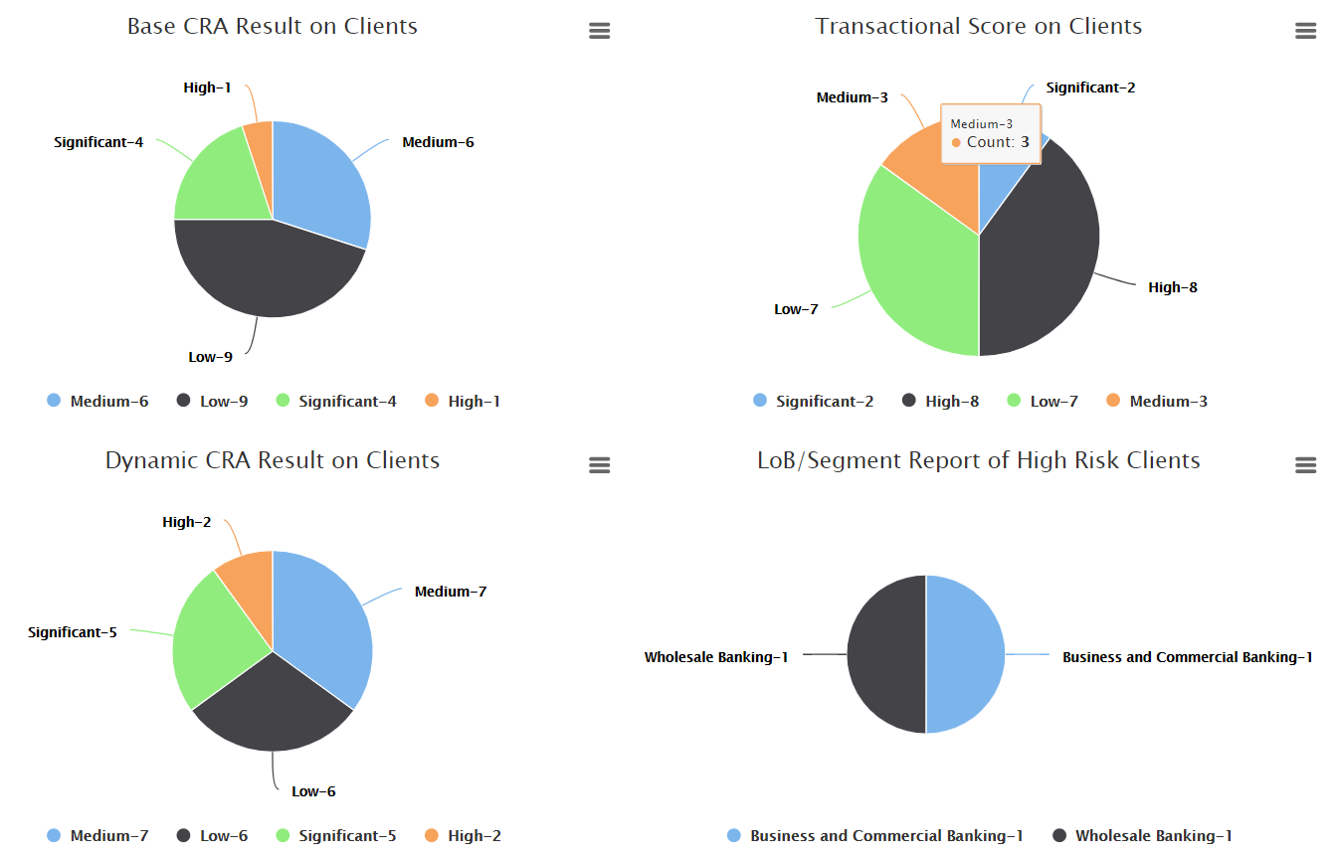
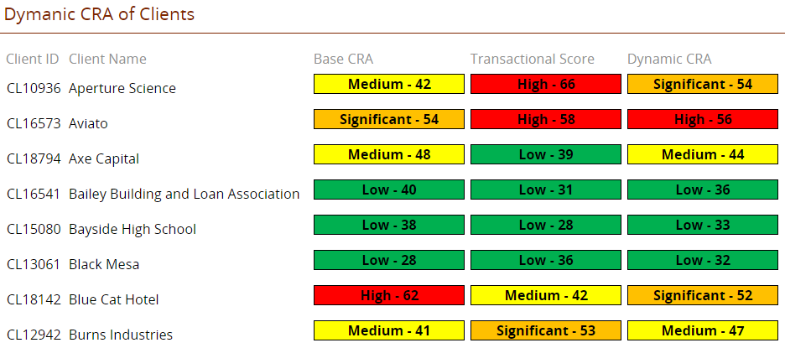
Client
Risk Assessment
Client risk assessment is automatically executed
based on a weighted average of client attributes
along with live transactional factors data.
Base CRA scores constitute a static value for each client.
Dynamic CRA scores are continuously calculated using
Base CRA Score and Transactional Factors Score together.
Master data sets can be automatically fed to Auditrunner
via web services, database links, and bulk data imports.
Dynamic CRA scores can be passed along to other applications
to update live data, and to trigger automation scenarios.

Slide 10
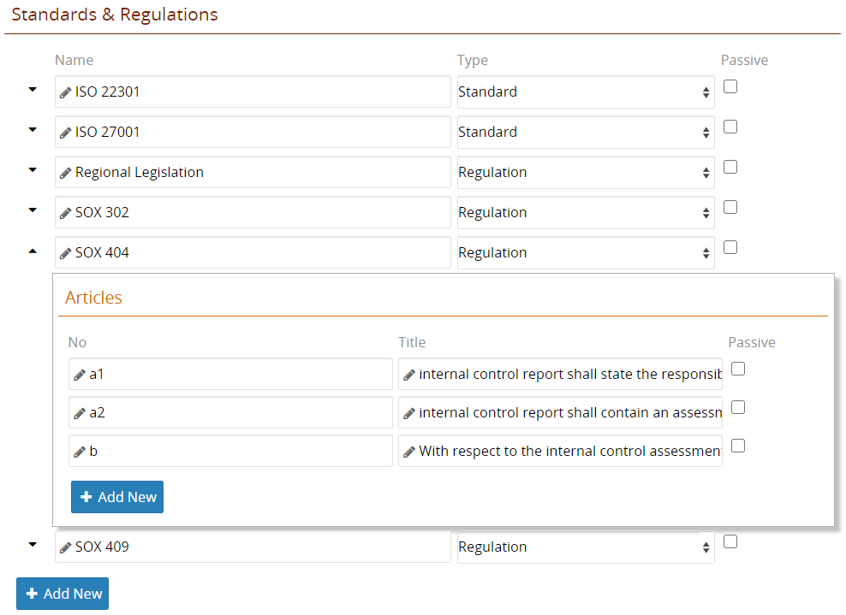
Sanctions Compliance Suite
Manage daily operations of Sanctions Compliance
Compliance
Catalog
Sanctions
Catalog
Compliance
Measures
Scan & Screen
Data
Compliance
Audits
Compliance Catalog
Compile all domestic and international regulations and standards on a single list.
Define practical interpretations of regulations, compile liabilities and obligations and assign action follow-up tasks to departments.
Integrate† with content providers to keep your catalog up-to-date.

Slide 11
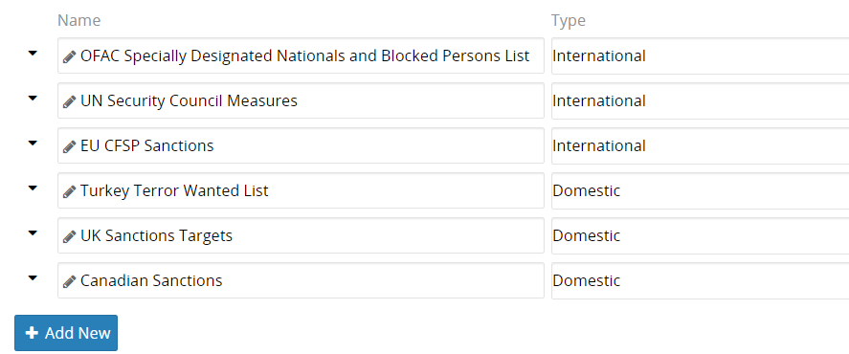
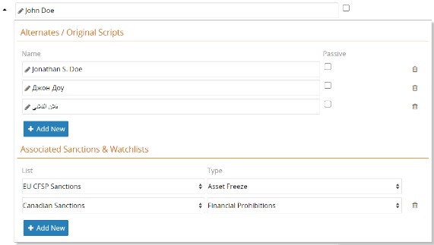
Sanctions Compliance Suite
Manage daily operations of Sanctions Compliance
Compliance
Catalog
Sanctions
Catalog
Compliance
Measures
Scan & Screen
Data
Compliance
Audits
Sanctions Catalog
Compile sanctions and watchlists of countries and international organizations.
Associate persons, companies, and other entities with multiple watchlists.
Integrate† with content providers to keep your catalog up-to-date.
Comply with any domestic or international AML legislations and measures.

Slide 12


Sanctions Compliance Suite
Manage daily operations of Sanctions Compliance
Compliance
Catalog
Sanctions
Catalog
Compliance
Measures
Scan & Screen
Data
Compliance
Audits
Proactive Measures
Reactive Measures
Continuously monitor active data and intervene
Scan the collected data and detect potential findings

Slide 13
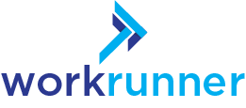
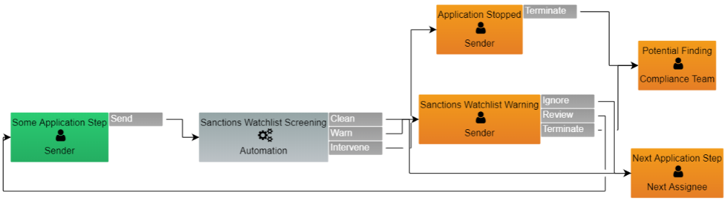





Sanctions Compliance Suite
Manage daily operations of Sanctions Compliance
Compliance
Catalog
Sanctions
Catalog
Compliance
Measures
Scan & Screen
Data
Compliance
Audits
Proactive Measures
Proactive measures can be implemented within all Workrunner business applications.
Active data of an application can be screened in real-time against the Compliance & Sanctions catalogs.
Screening can flag the data set “clean” and let the application proceed.
When a potential risk is discovered, business unit may be warned so that they can decide whether to proceed.
Screening can intervene and halt an application should a “red flag” arise, and notify the Compliance Team.

Slide 14









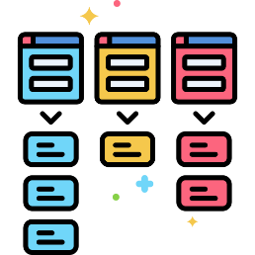
Sanctions Compliance Suite
Manage daily operations of Sanctions Compliance
Compliance
Catalog
Sanctions
Catalog
Compliance
Measures
Scan & Screen
Data
Compliance
Audits
Scan application
data
Findings, potential frauds, risks,
and outliers are highlighted
Notify compliance team
& initiate activities
Check against
Execute scenarios
& take automated actions
Sanctions
Catalog
Compliance
Catalog
Rule
Sets
Reactive Measures

Slide 15
Sanctions Compliance Suite
Manage daily operations of Sanctions Compliance
Compliance
Catalog
Sanctions
Catalog
Compliance
Measures
Scan & Screen
Data
Compliance
Audits
Scan data of
all applications
Scan & Screen Data
Auditrunner can scan data of all your business applications, check against Sanctions and Compliance Catalogs, and compile findings.
You can manually scan your applications at any time or schedule automated scans.
Check against
Sanctions
Catalog
Compliance
Catalog
Rule
Sets

Slide 16
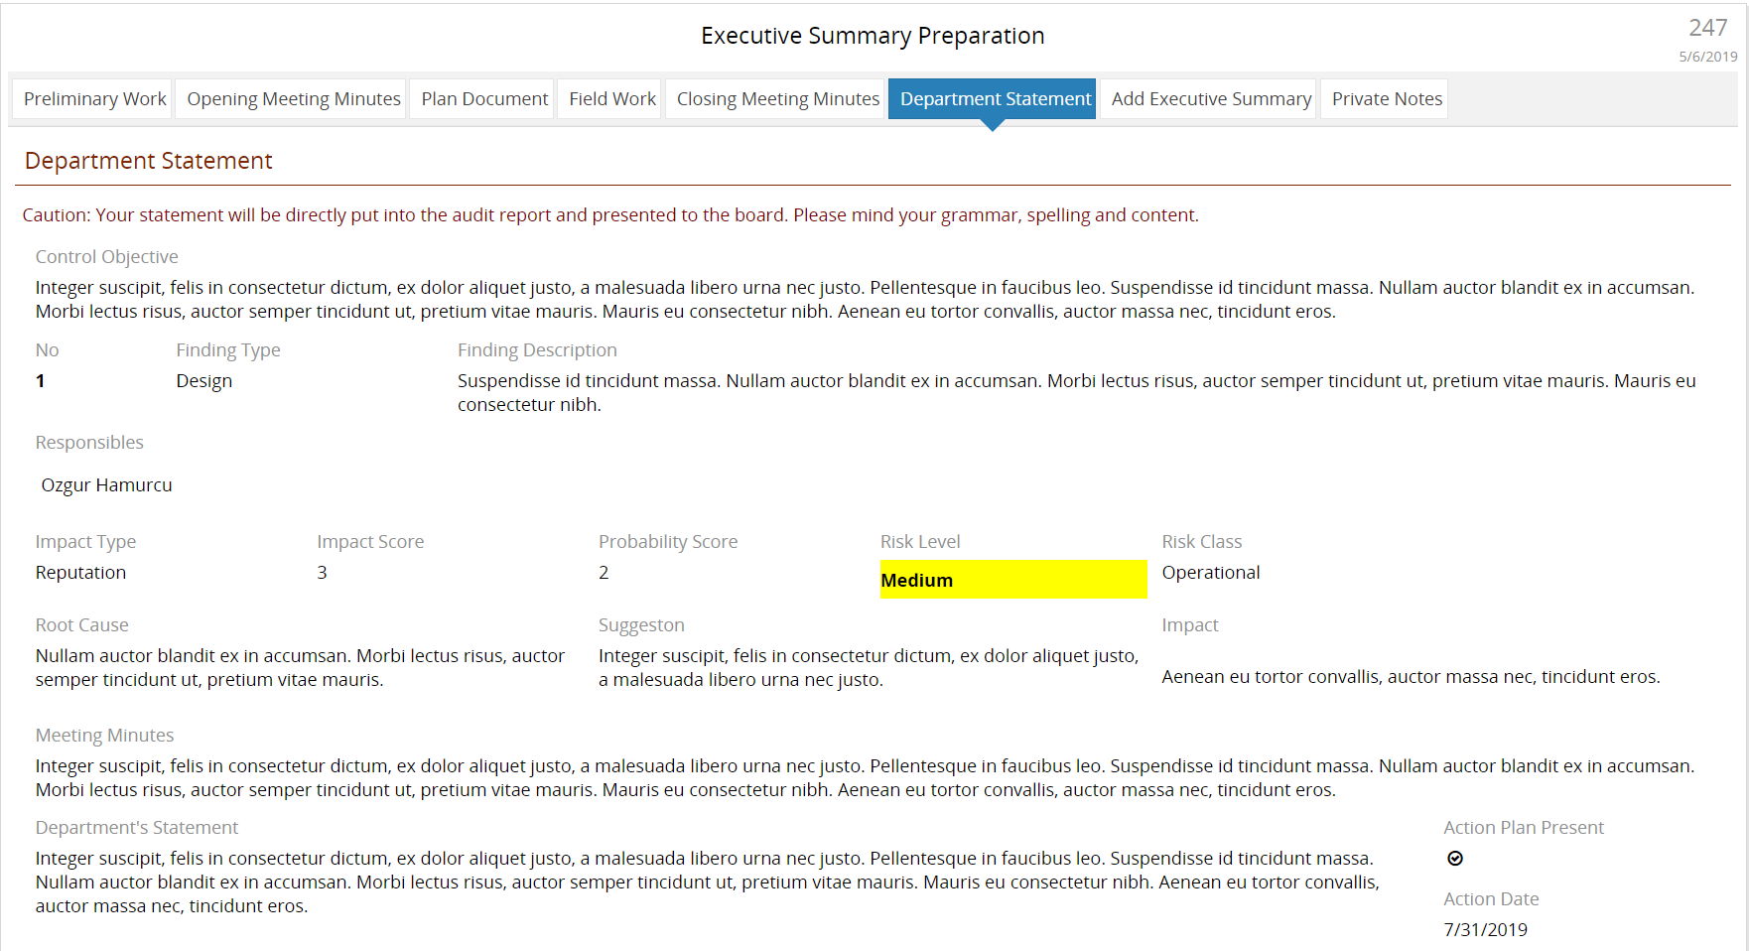
Sanctions Compliance Suite
Manage daily operations of Sanctions Compliance
Compliance
Catalog
Sanctions
Catalog
Compliance
Measures
Scan & Screen
Data
Compliance
Audits
Compliance Audits
Execute audit activities end-to-end, without requiring any other software, and create activity reports automatically at the end.

Slide 17

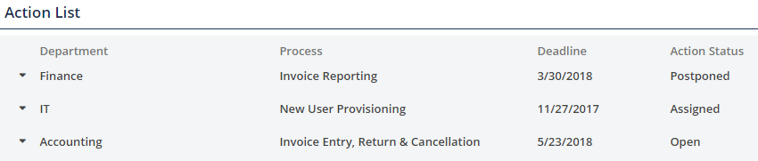
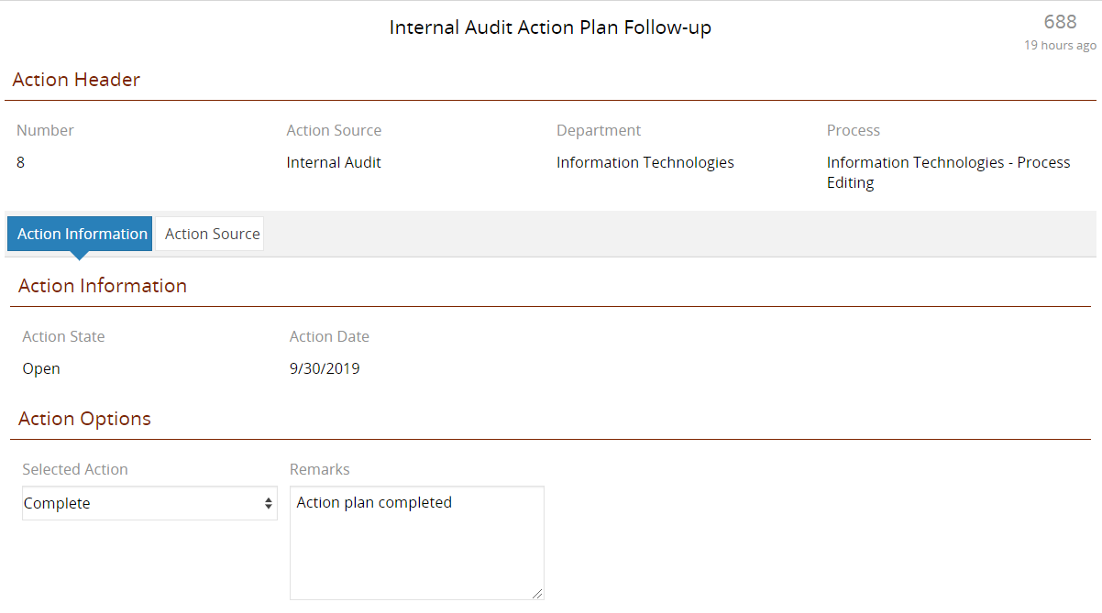
AuditRunner in Action
You are here
Action Follow-up &
Remediation
Action plans
for every finding, risk mitigation, corrective & preventive action or other activity are assigned as “tasks” to business units. Automate action status tracking.

Slide 18
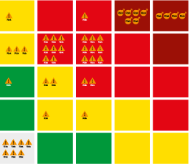
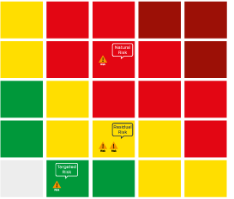
Risk Heat Map
Company-wide
IMPACT
Inherent Risk
LIKELIHOOD
IMPACT
Residual Risk
Risk Heat Map
Process Detail
Target Risk
LIKELIHOOD

Slide 19
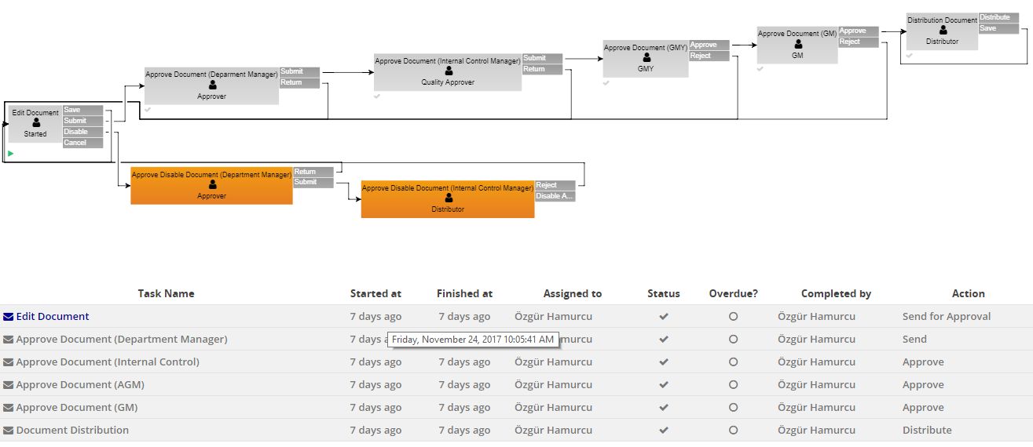
User Action Tracking
Who completed what and when, which action was taken, how much time was spent, is a task or an activity overdue?

Slide 20
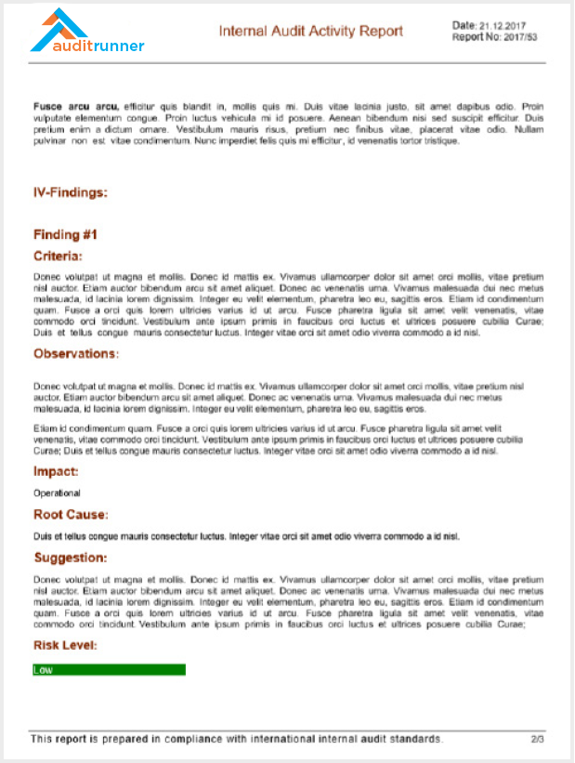
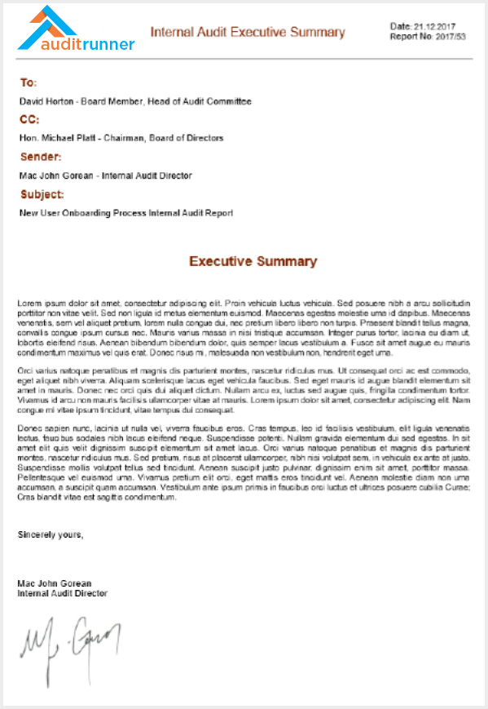
Automatically created
Activity Report
Automatically
created
Executive Summary
You are here

Slide 21
Increased Efficiency
Save considerable time and money throughout your organization
Capacity Increase
Time Savings
On-time Remediation
Cost Savings
Number of executed annual activities
increases steadily,
without new auditors.
Average time spent to prepare and finalize
audit reports decreased from 2 weeks to 2 days.
Preemptive notifications and escalation options has resulted 81% of all action plans to be completed on-time.
Expenses on resources such as external auditors, consultants and other resources are reduced more than half.

Slide 22

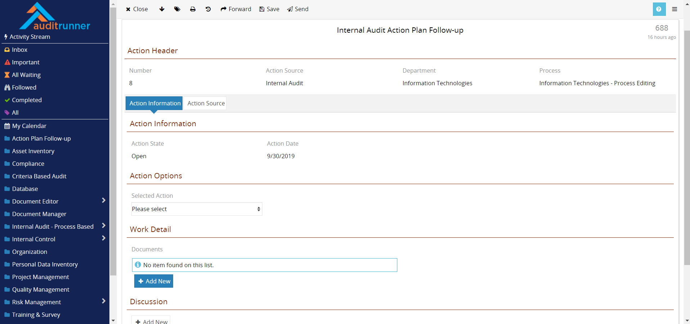

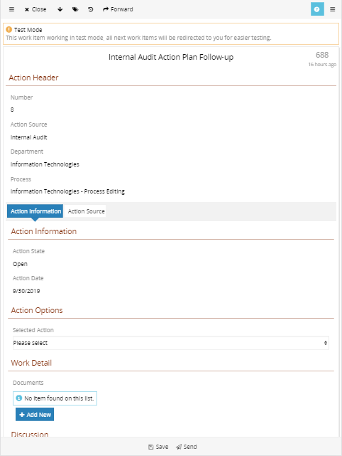

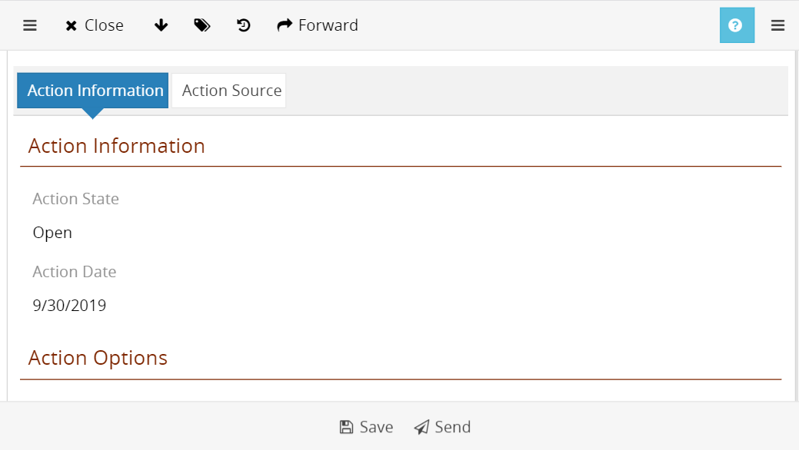
Access
with any device
Web-based & responsive user interface
No installation on end-user device
No extra development for mobile view
No extra licenses for mobile access
Same content & same functionality

Slide 23
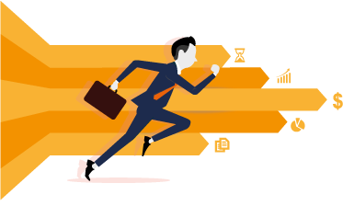

Auditrunner
Solution Approach
Continuous feedback
& Solid progress
Business perspective
Short development cycles and frequent feedback to deliver continuous and solid progress without months-long schedules.
Clearly understand and guide business units.
360° analysis
of your business
Save time
and money
Improvements
& Updates
Collaboration with not just IT departments but with business owners.
Low-code application platform enables delivery of adaptations and new developments in 1/3 time.
Continuous upgrades and updates based on user feedback, to keep applications always aligned with ever-changing business needs.

Slide 24
Typical Work Chart for On-premise Setup
Auditrunner Core platform installation & configuration
3 man-days
Installation & initial configuration of selected modules
4 man-days
HR Software & Authentication (LDAP/OAuth) integration
4 man-days
Extra integrations (per integration interface)
3 man-days/service
Customizations & extra development (3x-4x faster than traditional environments)
Depends on scope
*Given timeline is based on the assumption that all items of Client data, components of Client infrastructure and integration interfaces are adequately prepared and ready for use.

Slide 25
Typical Work Chart for Cloud (SaaS) Setup
Auditrunner Cloud tenant provisioning & initial configuration
2 man-days
Installation & initial configuration of selected modules
4 man-days
HR Software & Authentication (LDAP/OAuth) integration
4 man-days
Extra integrations (per integration interface)
3 man-days/service
Customizations & extra development (3x-4x faster than traditional environments)
Depends on scope
*Given timeline is based on the assumption that all items of Client data and integration interfaces are adequately prepared and ready for use.

Slide 26

Operational Solutions

Slide 27
Operational Solutions
Sales & Channel Management
New Store/Point Feasibility Analysis
Store Opening & Closing Processes
Dealer Advance & Security Payments
Dealer Channel Organization
Customer Relations Management
Distribution Channel Organization
Order Input & Tracking
Services & Project Sales
Distant Sales
Customer Service – Ticketing
Technical Service – Ticketing
Supplier Management
Sales Support
Periodic Discounts & Special Offers
R&D, Marketing, Product Management
Artwork Management
Product Development Project Mgmt
Innovation Idea Screening
Product Lifecycle Management
R&D Project Management
Government Grants Management
Marketing Project & Strategy Mgmt
Human Resources
eLearning & eTraining
Advance Payments
Trial Run Evaluation
eSurveys, eTests & eCertificates
Duty Forms
Job Descriptions
Expense & Travel Management
Human Resource Management
Sign-on & Orientation
Cease of Employment
Leave Requests
Team Management
Channel Organization Management
Interviews & CV Pool
Organization Structure Management
Performance Evaluations - 180⁰ & 360⁰
Career Management
Personnel Records
Competence & Background Pool
Position Changes
Promotions & Demotions
Nominations & Appointments
Timekeeping
Medical Reports
New Headcount Request
Financial Operations
CAPEX Investment Management
OPEX Expenditure Management
Loan Operations & Refinancing
Cash Flow Management
Real Estate & Property Management
Asset Management
Banking
Fund Transfer Management
Receipt Cancellation
Group Transfers
Card & POS Operations
Loan Application & Approval
Customer Visit Planning & Pricing
Insurance, Life & Pension
Intermediary Advance & Security Payments
Actuary Period Closure
Individual Insurance Policy Management
Individual Pension Policy Management
Group Pension Policy Management
Policy Support
Document Quality Control
Operational & Transactional Processes
Collection & Reconciliation
Cancelation & Abandonment
Damage Evaluation & Payments
Risk Evaluation & Underwriting
General Operations
Asset & Inventory Management
Document Editor & Manager
Electronic Signature
Incoming/Outgoing Document & Parcel Management
Electronic Invoice
Incoming Invoice Approval & Recognition
Outgoing Invoice Approval & Issuance
Request Management (Ticketing)
Project Management
Procurement
Contract Management & Tracking
Stock & Inventory Management
Meeting Management & Task Tracking
Liability Management
Information Technologies
IT Project Management
IT Procurement
IT Request Management (Ticketing)
Application Access Control Rights Mgmt
File Transfer API
Batch & Singular Electronic Signing

Slide 28
In reality, being an effective internal auditor ultimately hinges on one's ability to be an agent of change.
- Richard Chambers
Do you have the right tools to be
AGENTS OF CHANGE?
28

Slide 29
Thanks.
Questions?

Slide 30

Get in
touch
Contact Information
4048 Lick Mill Blvd, Santa Clara, CA
Auditrunner
+1 650 206 2368
sales@auditrunner.com
The Low-code Audit, Risk, Compliance & Quality
Management Software
www.auditrunner.com
Visit Us

