Slide 1
Product Lifecycle
Management Platform

Slide 2
Low-code Application Environment
Flexible
Operate in a highly responsive manner
in today‘s fast-moving, ever-changing environment that presents multitude of challenges.
Customizable
Adapt to the evolving changes of your growing organization and address the requirements of the entire user community.
Collaboration
Bring together all departments
on a single platform. Address the requirements of the whole community.
Scalable
Scale up or across using our modules to respond easily to organizational shifts, competitive threats, industry innovations and regulatory changes.
Integration
Establish integrations with
any third-party system or software
for two-way data stream,
automation and orchestration scenarios.
No installation
Access the same content and function using any kind of device, without any installation.

Slide 3



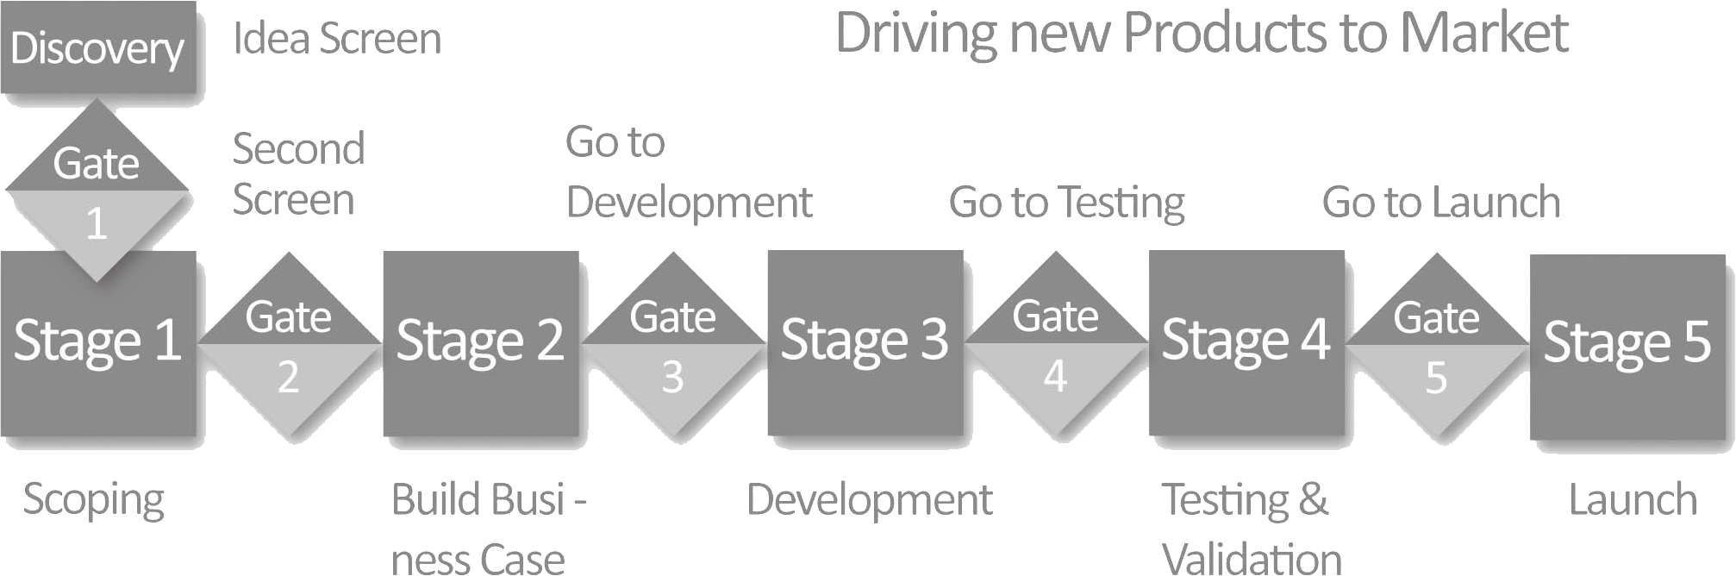
Stagest
Product Lifecycle
Management Platform
3000+
product management projects handled on Stagest

Slide 4
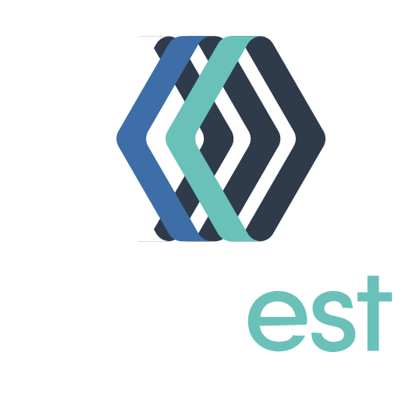
Stagest is designed for managing
  new product, brand or market entry,
    current business continuity,
      product renovation or delisting,
        innovation and idea management projects of enterprises.

Slide 5
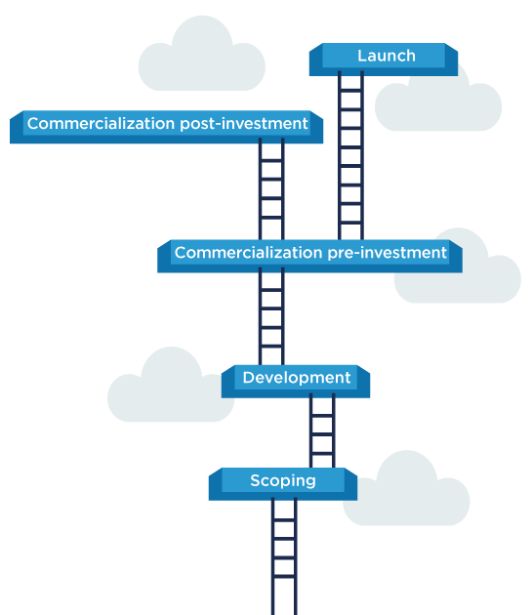
What is
Stage-Gate™?
Stage-Gate is a modular project management methodology, which is widely accepted especially among product development circles.
A Stage-Gate project consists of predetermined and sequential steps, or “stages”. Each stage consists of a set of certain cross-functional and parallel activities which must be successfully completed prior to obtaining management approval to proceed to the next stage.
At the end of each stage, the overall progress is sent for “gate” approval. These “gates” control the process and serve as:
Quality control of the completed stage
Go/No-Go check-points
Readiness-checks
Must-Meet and Should-Meet criteria
Marker for action plan for the next stage

Slide 6
Executed with Stagest
Sample Projects
New Product or Brand Innovation
Business Continuity
Create, add new items to or spin-off
a product/brand
Sustainability projects
Market share growth
Market share retention
Marketing Strategy
Market Innovation
Co-packing & bundling
Co-production
Localized production
Entering a new market
Adapting products for a new market
Delisting
Complete or partial product delisting
Product renovation
Brand delisting

Slide 7
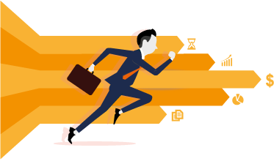

Workrunner
Solution Approach
Continuous feedback
& Solid progress
Business perspective
Short development cycles and frequent feedback to deliver continuous and solid progress without months-long schedules.
Clearly understand and
guide business units.
360° analysis
of your business
Save time
and money
Improvements
& Updates
Collaboration with not just IT departments but with business owners.
Low-code application platform enables delivery of adaptations and new developments in 1/3 time.
Continuous upgrades and updates based on user feedback, to keep applications always aligned with ever-changing business needs.

Slide 8

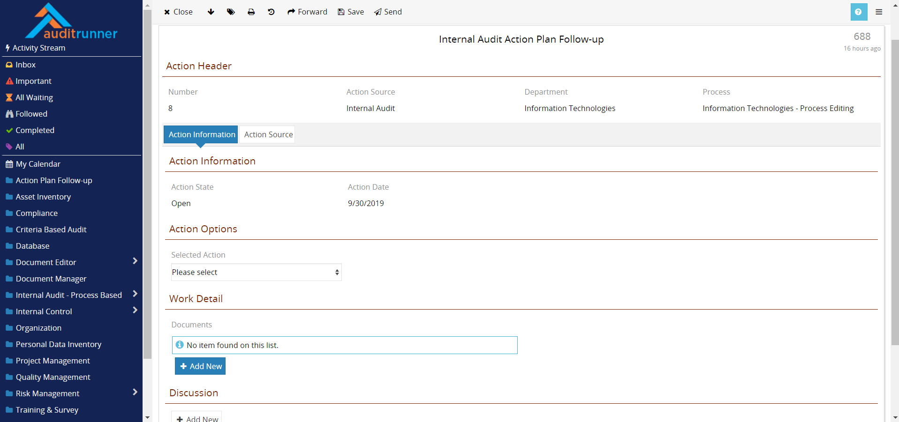

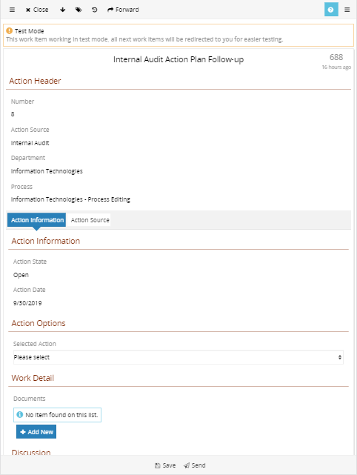

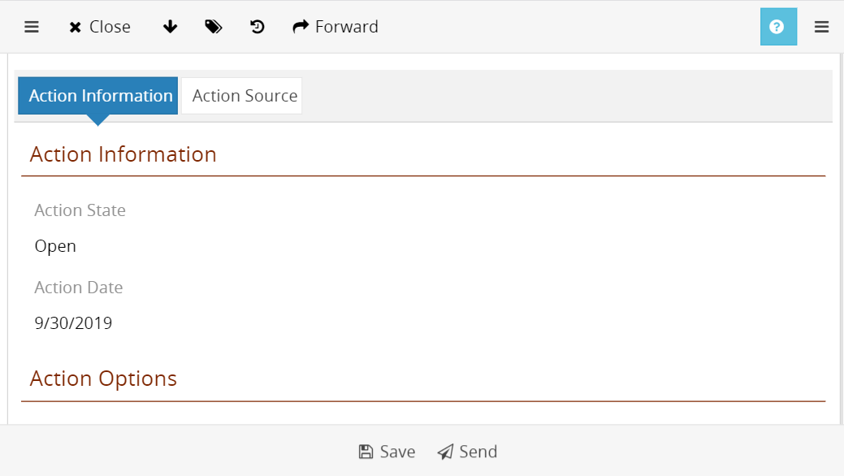
Access
with any device
Web-based & responsive user interface
No installation on end-user device
No extra development for mobile view
No extra licenses for mobile access
Same content & same functionality

Slide 9
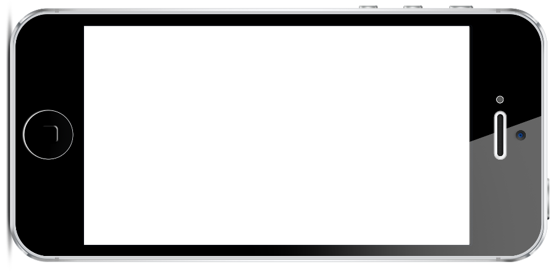
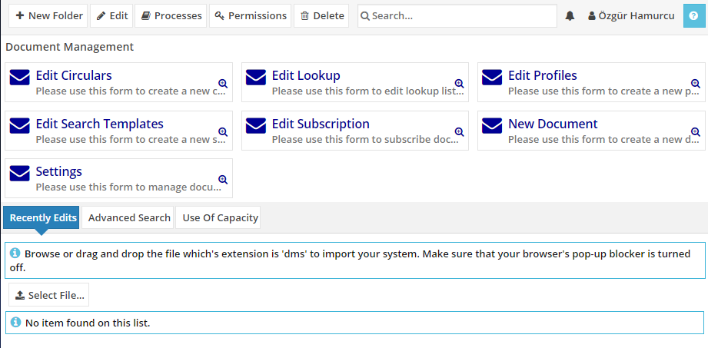
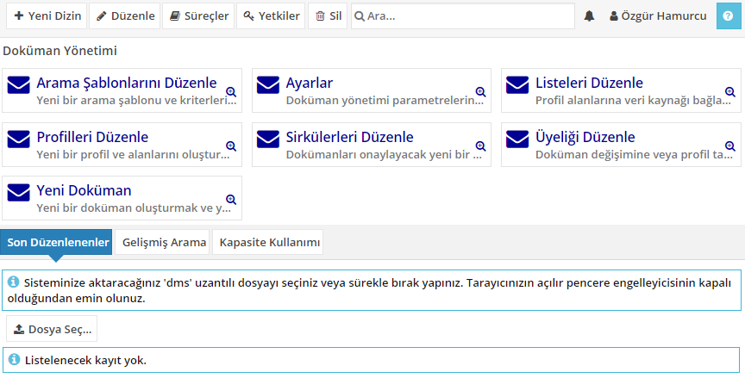
Multi-language Support
Use multiple languages
at once
Every user can use his/her
own language
Same content in
different languages
Same functions in
different languages

Slide 10
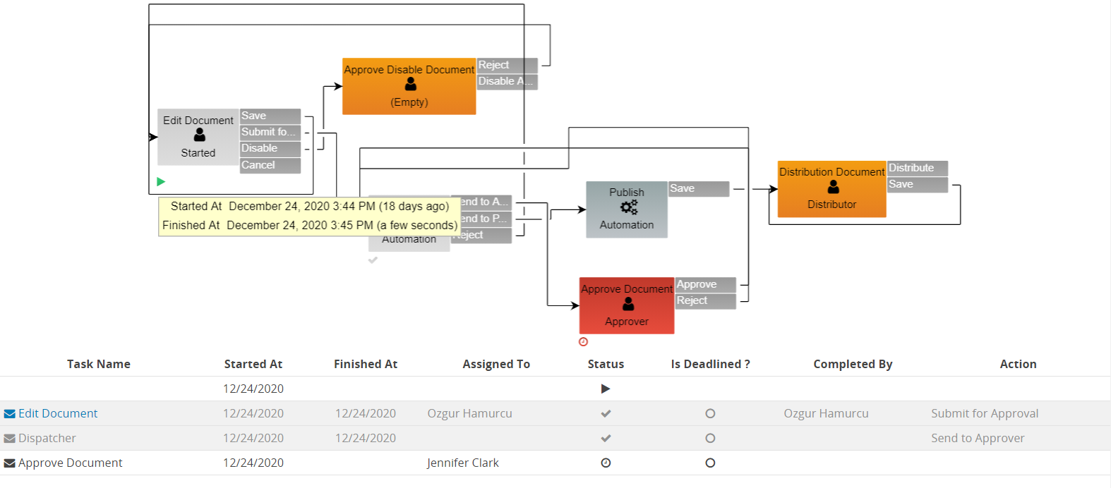
Track
every action
Track the action history of each and every workflow
Report actions taken in different time zones
Who completed what and when?
Which action was taken?
How much time is spent at every step?
Has an action or a flow become overdue?
Trackability, accountability & performance data

Slide 11
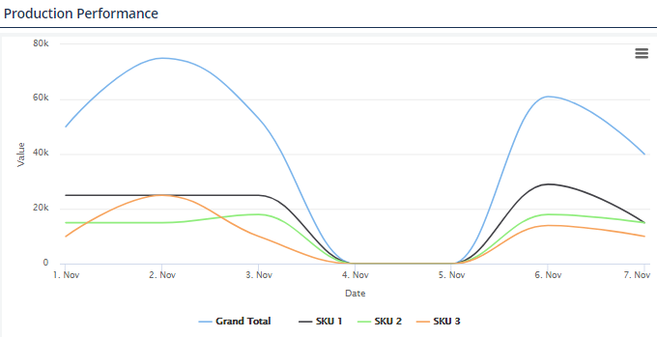
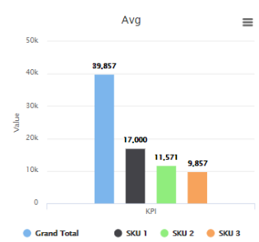
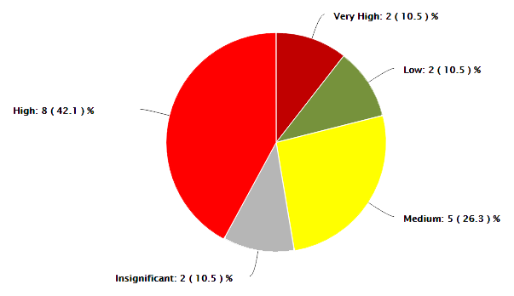
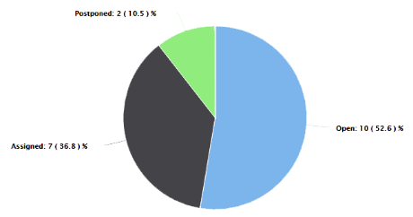
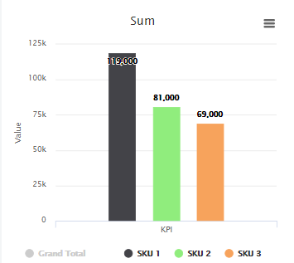
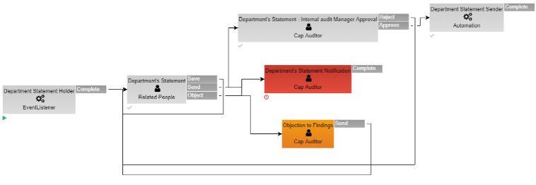
Dashboards
and Reports

Slide 12













Stagest
Users

Slide 13


pladis Global Case Study

Slide 14
Case Study
WorkRunner’s global experience
helped us to manage our global projects easier
with our teams in UK, US and Europe.
Ali Sencan - pladis Global
WorkRunner G2 Review

Slide 15
6 Regions, Single Platform
Case Study
Multiple Applications on Workrunner
Innovation processes were executed on multiple applications in a distributed manner by separate subsidiaries in 15 different countries in 6 regions.
All this distributed network is now unified
on WorkRunner.
United Kingdom & Ireland
Turkey, Romania & Central Asia
Middle East & North Africa
North America
Europe
Emerging Markets

Slide 16
Efficient Use of Resources
Case Study
Better Management of Resources
“Cancellation of the innovation projects by gatekeepers for valid reasons
at different stages, saves invaluable time & resources that
would otherwise be wasted unnecessarily."

Slide 17
Case Study
Projects are
Target in-Store Date
Completed
On-time
Target in-Store Date
“95% of projects are delivered on target in-store dates and product launches are made on time.
This enables the smooth running of the projects and preventing market opportunity losses.”
Projects completed on-time
Market opportunities
are not missed

Slide 18
Case Study
More than 2,000 projects have been managed
with clear visibility & transparency
on WorkRunner in the last 3 years.
18

Slide 19
Case Study
Return on Investment
Return
on Investment
WorkRunner Returns
“In this case,
£ 190 M total budget of the projects
3% savings on costs with WorkRunner
£ 5 M annual benefit is generated.”
WorkRunner returns more than 50 times
on initial investment.
WorkRunner RoI
.

Slide 20
Thanks.
Questions?

Slide 21
Get in
touch
Contact Information
4048 Lick Mill Blvd, Santa Clara, CA
+1 650 206 2368
Stagest
sales@workrunner.io
Product Lifecycle
Management Platform
www.workrunner.io
Visit Us

