Slide 1
Onboarding Management Platform
powered by workrunner.io

Slide 2
Low-code Application Environment
Flexible
Operate in a highly responsive manner in today‘s fast-moving, ever-changing environment that presents multitude of challenges.
Customizable
Adapt to the evolving changes of your growing organization and address the requirements of the entire user community.
Collaboration
Bring together all departments on a single platform. Address the requirements of the whole community.
Scalable
Scale up or across using our modules to respond easily to organizational shifts, competitive threats, industry innovations and regulatory changes.
Integration
Establish integrations with any third-party system or software for two-way data stream, automation and orchestration scenarios.
No installation
Access the same content and function using any kind of device, without any installation.

Slide 3
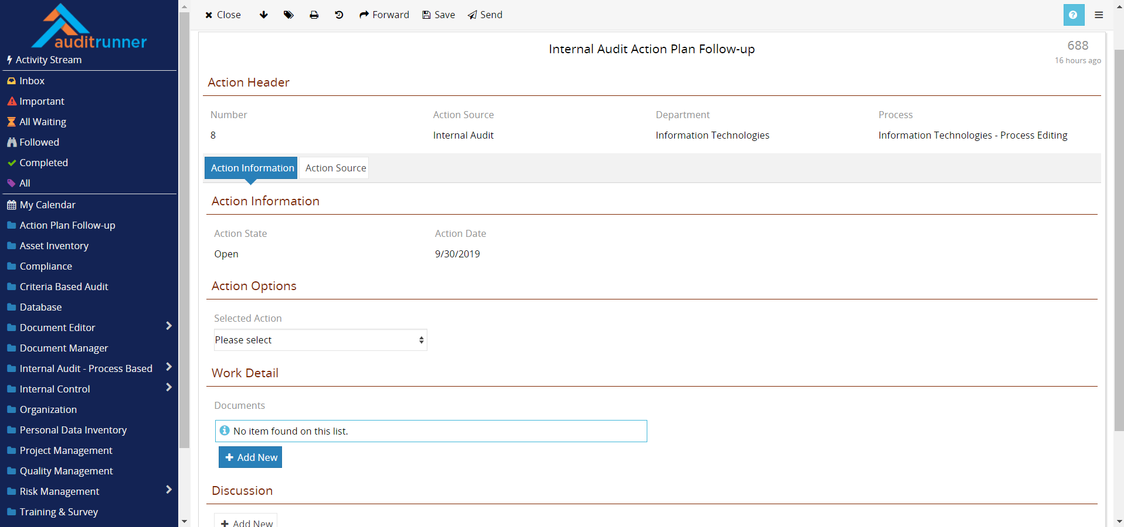
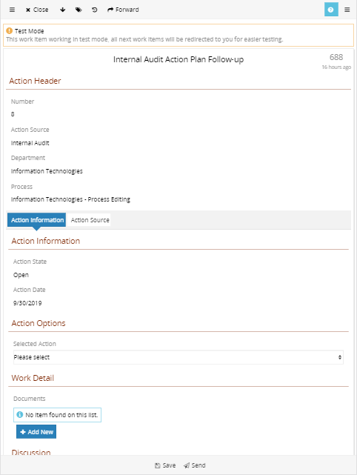
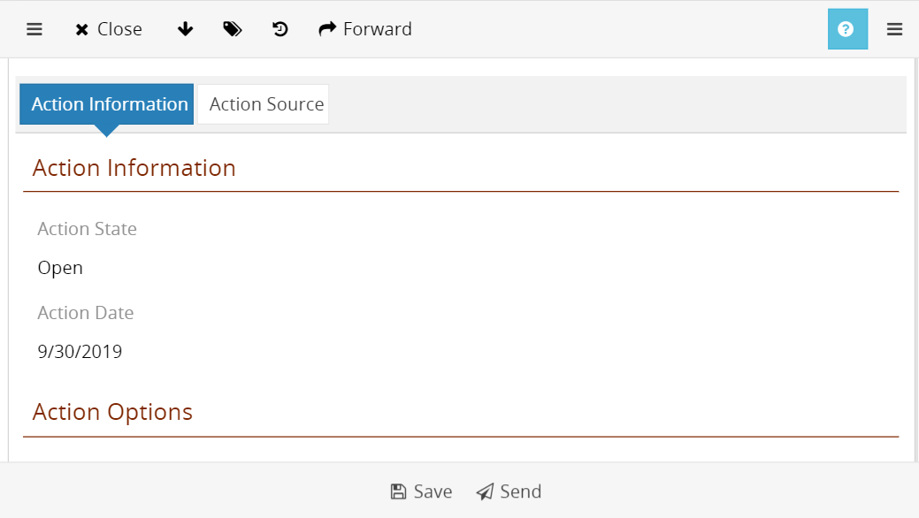
Access with any device
Web-based & responsive user interface
No installation on end-user device
No extra development for mobile view
No extra licenses for mobile access
Same content & same functionality

Slide 4
Process Oriented Approach
Process Analysis
Implementation
Improvements & Updates

Slide 5
WR OnBoard

Slide 6
WR OnBoard application helps companies automate the process of voluminous new partner, supplier, and client onboarding
on a single and unified
digital platform.
6

Slide 7
Increased Efficiency
Save considerable time and money at your operations
Number of Vendors
Time Savings
Resource Savings
Vendor Satisfaction
Number of Vendors increased dramatically from 3,000 to 60,000, i.e. by 20 fold in 2 years
Average duration of Vendor applications decreased from 5-7 days to 4 hours – 2 days.
Onboarding department saved 40 man-days per employee over a year period.
Vendor retention rate after the initial application raised by 18%.

Slide 8
WR OnBoard
Onboarding Process
Evaluation
Portfolio Details
Vendor Account
Applicant’s products and services, are evaluated against pre-determined criteria like credit score and market reputation.
Vendor’s products and services are analyzed and uploaded to be added into the portfolio
All Vendor lifecycle communication, payments and action details are logged centrally.
Application
Registration
Control
Vendor applications are gathered through different channels such as website and e-mail
Approved Vendor shares documents and information to create a vendor account.
Vendor’s products and services are evaluated and positioned to an appropriate setting

Slide 9
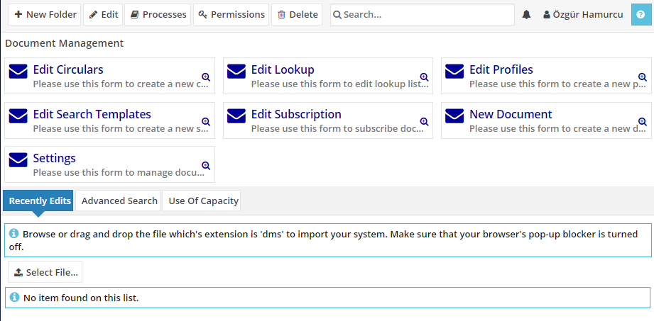
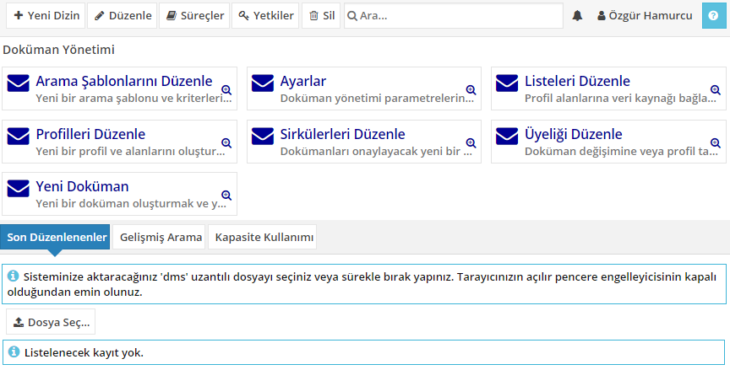
Multi-language Support
Use multiple languages at once
Every user can use his/her own language
Same content in different languages
Same functions in different languages

Slide 10
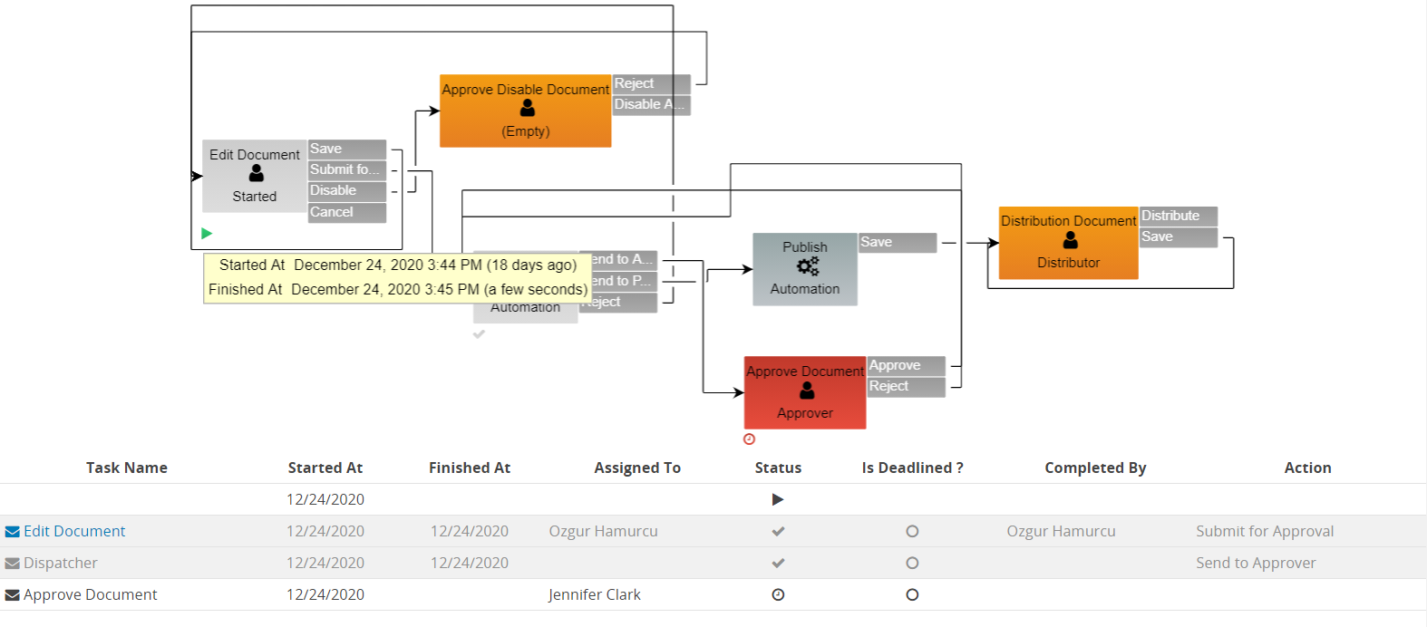
Track every action
Track the action history of each and every workflow
Report actions taken in different time zones
Who completed what and when?
Which action was taken?
How much time is spent at every step?
Has an action or a flow become overdue?
Trackability, accountability & performance data

Slide 11
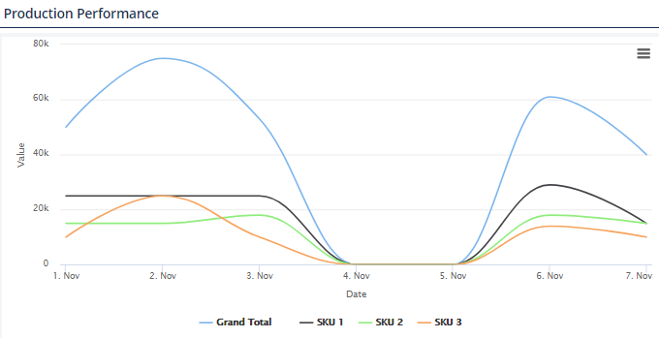
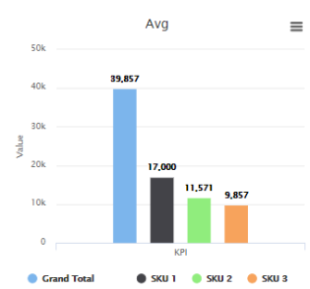
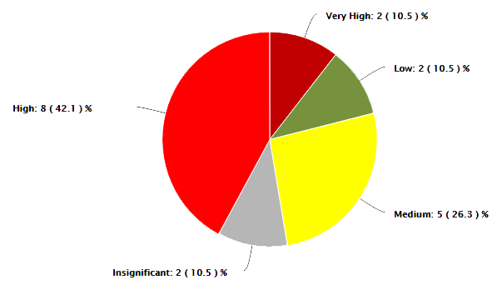
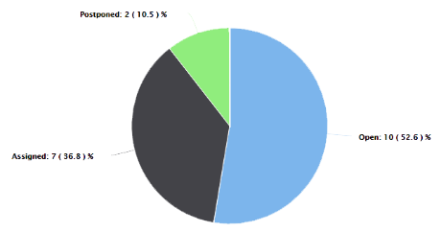
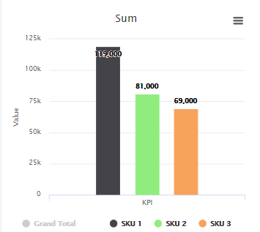
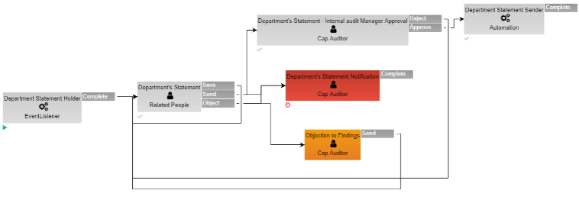
Dashboards & Reports

Slide 12
Thanks.
Questions?

Slide 13
Get in
touch
Contact Information
4048 Lick Mill Blvd, Santa Clara, CA
+1 650 206 2368
Workrunner
sales@workrunner.io
The Low-code Application Development Platform
www.workrunner.io
Visit Us

