Slide 1
Low-code
Application Development Platform

Slide 2
Low-code Application Environment
Flexible
Operate in a highly responsive manner
in today‘s fast-moving, ever-changing environment that presents multitude of challenges.
Customizable
Adapt to the evolving changes of your growing organization and address the requirements of the entire user community.
Collaboration
Bring together all departments
on a single platform. Address the requirements of the whole community.
Scalable
Scale up or across using our modules to respond easily to organizational shifts, competitive threats, industry innovations and regulatory changes.
Integration
Establish integrations with
any third-party system or software
for two-way data stream,
automation and orchestration scenarios.
No installation
Access the same content and function using any kind of device, without any installation.

Slide 3

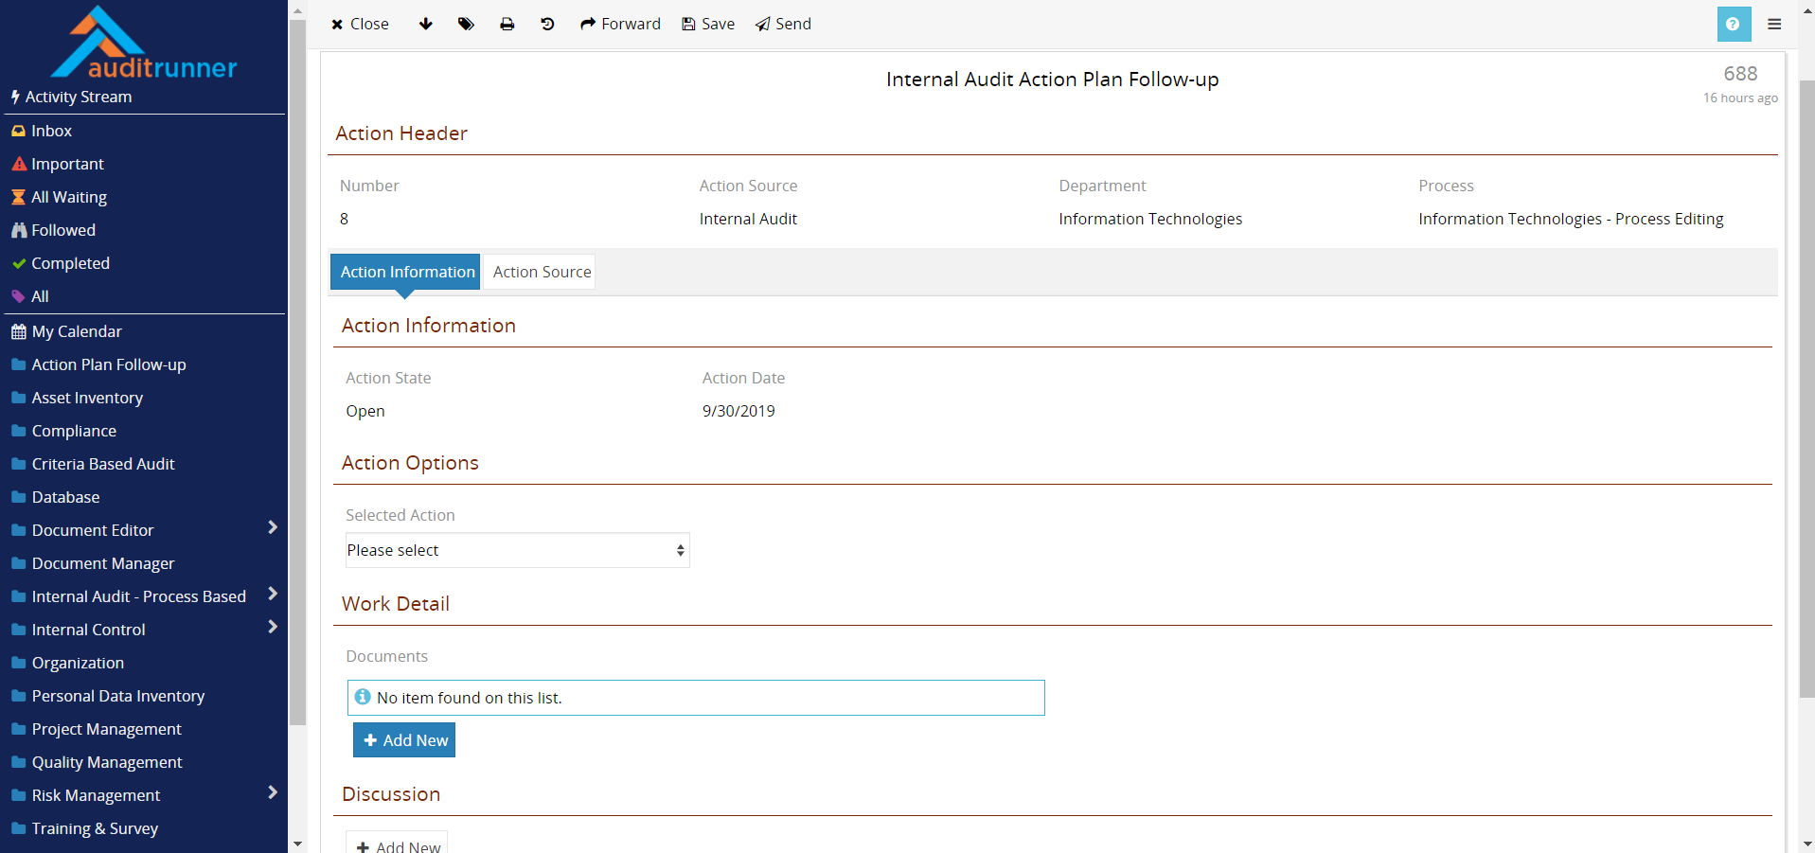

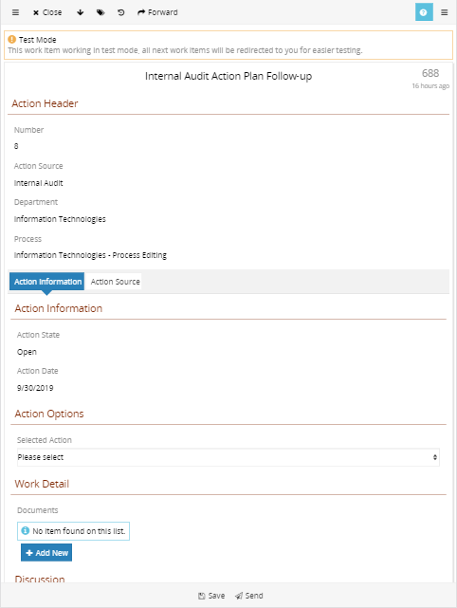

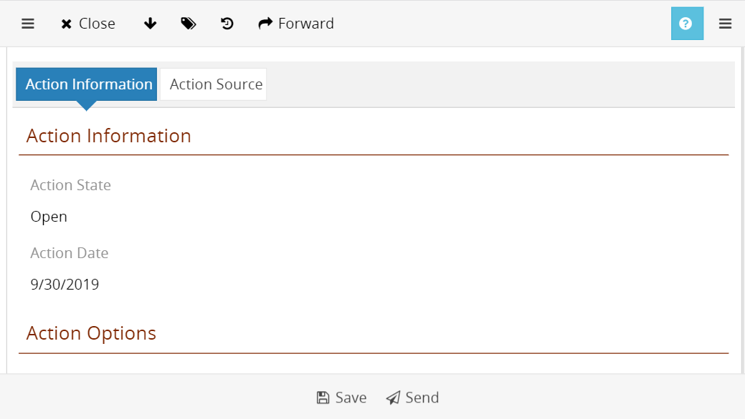
Access
with any device
Web-based & responsive user interface
No installation on end-user device
No extra development for mobile view
No extra licenses for mobile access
Same content & same functionality

Slide 4
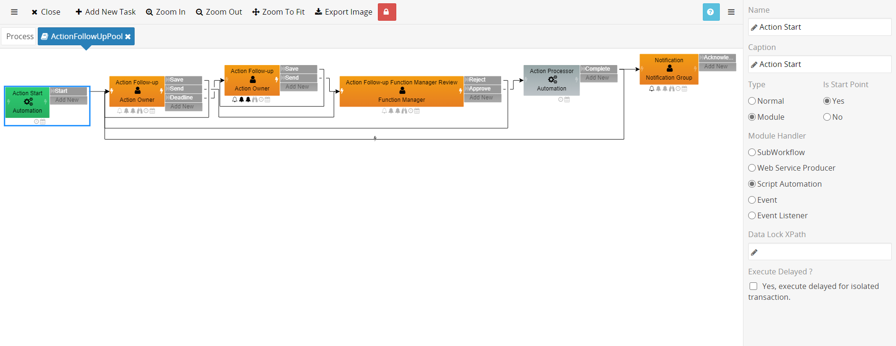
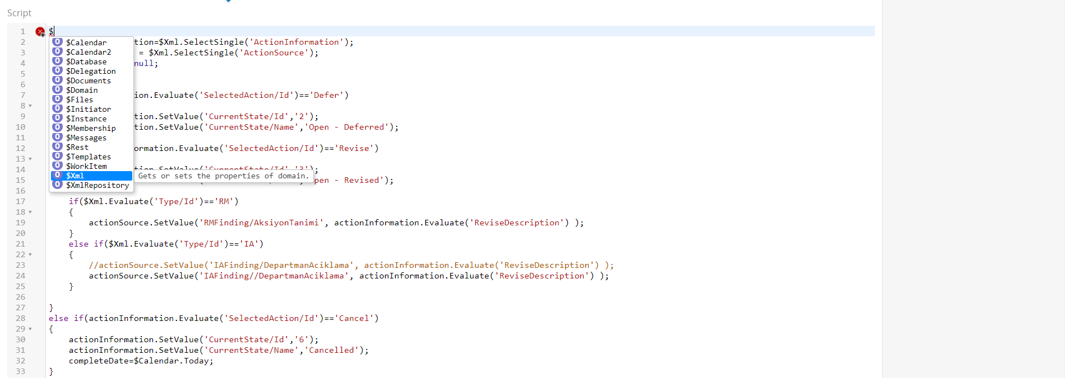
Web-based
low-code development
Create complex applications with minimal coding knowledge
Roll-out applications in one-third amount of time
No installation for developer
No extra development for mobile view
Integrate with any system via web services
No deployment & instant testing
Automation & orchestration scenarios

Slide 5
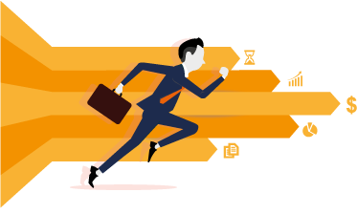

Workrunner
Solution Approach
Continuous feedback
& Solid progress
Business perspective
Short development cycles and frequent feedback to deliver continuous and solid progress without months-long schedules.
Clearly understand and
guide business units.
360° analysis
of your business
Save time
and money
Improvements
& Updates
Collaboration with not just IT departments but with business owners.
Low-code application platform enables delivery of adaptations and new developments in 1/3 time.
Continuous upgrades and updates based on user feedback, to keep applications always aligned with ever-changing business needs.

Slide 6

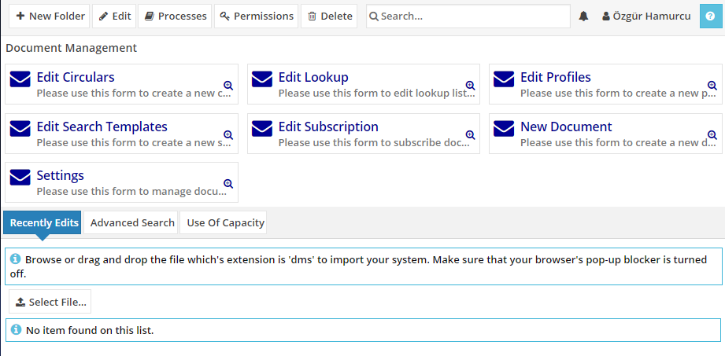
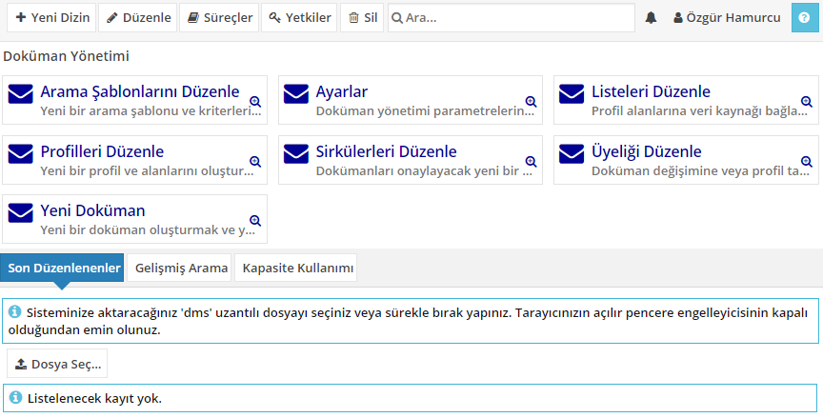
Multi-language Support
Use multiple languages
at once
Every user can use his/her
own language
Same content in
different languages
Same functions in
different languages

Slide 7
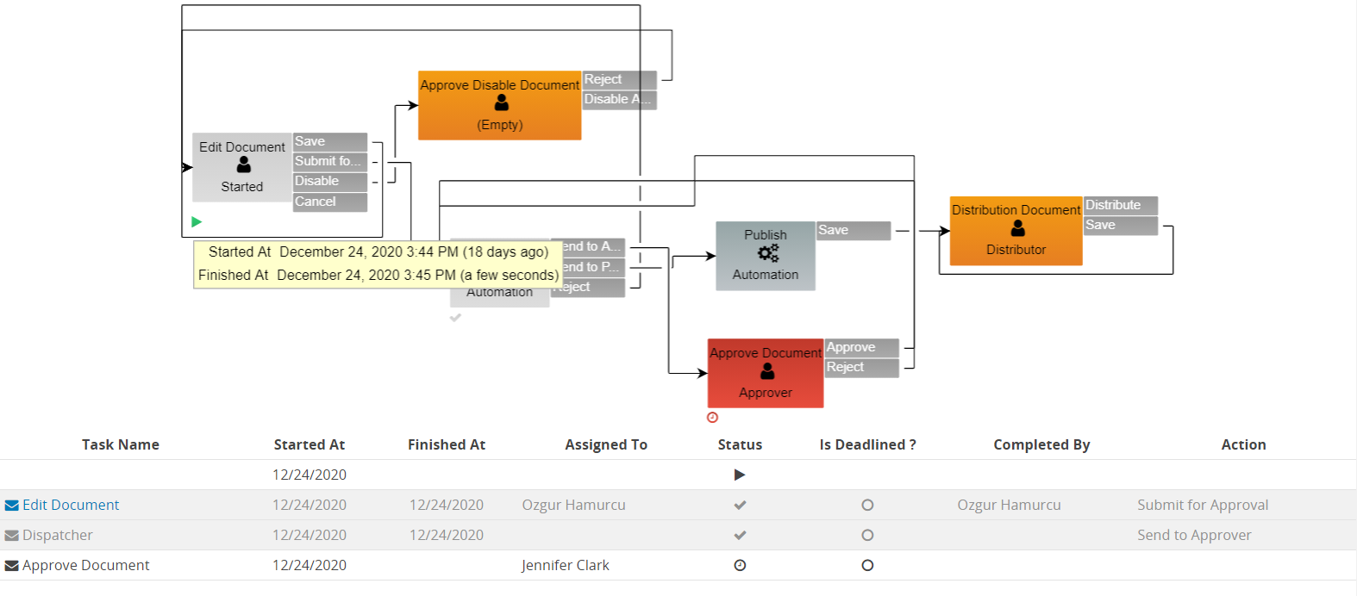
Track
every action
Track the action history of each and every workflow
Report actions taken in different time zones
Who completed what and when?
Which action was taken?
How much time is spent at every step?
Has an action or a flow become overdue?
Trackability, accountability & performance data

Slide 8
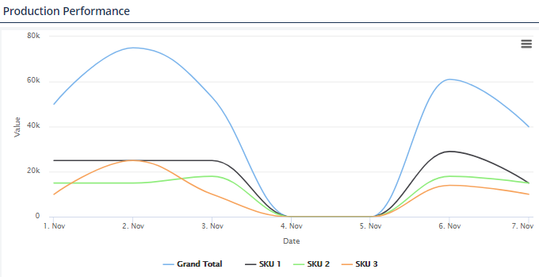
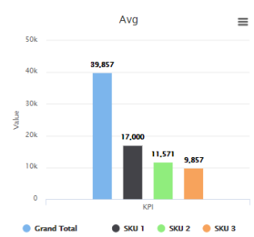
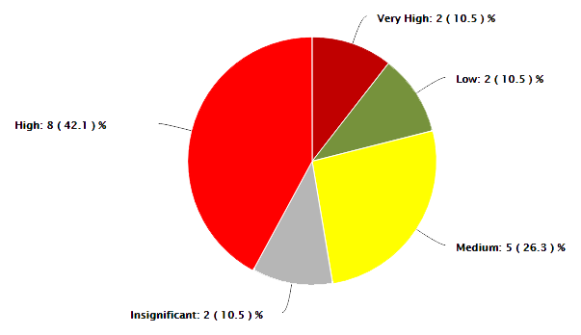
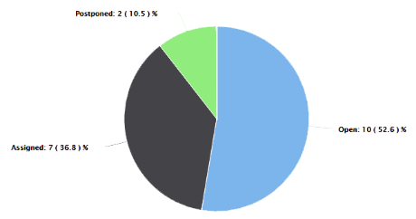
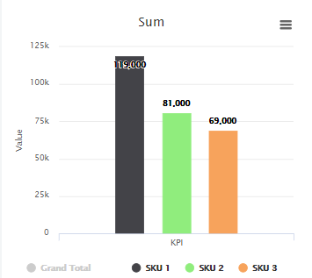
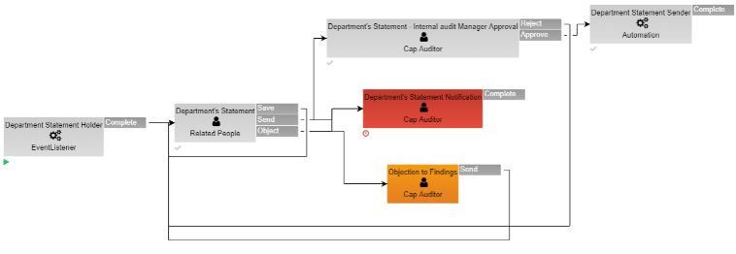
Dashboards
and Reports

Slide 9

Application Suites

Slide 10


AuditRunner
GRC Solution
55%
85%
Comprehensive GRC
AuditRunner is designed
as a comprehensive software platform that encompasses all facets of Governance, Risk and Compliance
Expenses on resources such as external auditors, consultants etc.
are reduced more than half.
Average time spent to prepare and finalize
audit reports decreased from 2 weeks to 2 days.

Slide 11













Complete GRC Management
Establish collaboration throughout your organization with Auditrunner
Internal Audit
Risk & Controls
Quality Assurance
Compliance
Administer all your internal audit
activities in line with IIA instructions
Build up your company-wide risk inventory
and control environment
Establish quality accreditations and
execute specialized activities
Ensure compliance with legislations and
collect all data in a single system
Process Risk Assessments
Process Audits
Investigations
Ethical Breach Reporting
Risk & Opportunity Management
Risk Inventory & Heatmap
Control Environment
Internal Control Activities
Quality Assurance Audits
Customer Complaints ISO9001
Corrective Actions ISO9001
Information Assets ISO27001
Business Continuity ISO22301
Compliance Audits
Responsibility Management
Liability Management
Personal Data Inventory GDPR
Data Protection Compliance

Slide 12




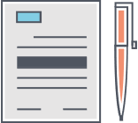


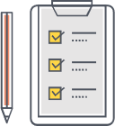
Complete Internal Systems
Establish collaboration throughout your organization with Auditrunner
Process Catalog
Action Follow-up
Document Editor
Meeting Manager
Compile business processes associated with
documents and flowcharts
Track the progress of action plans for findings, risk mitigation and other activities
Create, manage, revise and publish all internal documentation
Organize and execute meetings, create meeting minutes and assign action plans
Standards & Regulations Catalog
BPM Modelling
Document Manager
e-Training & e-Survey
Model flow charts of processes with BPMN2 notation, create RACI and SIPOC matrices
Digitalize & archive
all printed documents,
create automation scenarios
Create and distribute training material, tests and surveys. Evaluate results and issue certificates.
Compile governing regulations and standards associated with documents and literature

Slide 13
Digitalizing Governance
Auditrunner’s Two-Pillar Approach
Internal Audit
Quality
Assurance
Internal
Processes
Standards
&
Regulations
Control
Environment
Risk
Management
Information
Security
Compliance
Process-based Governance
Criteria-based Governance

Slide 14

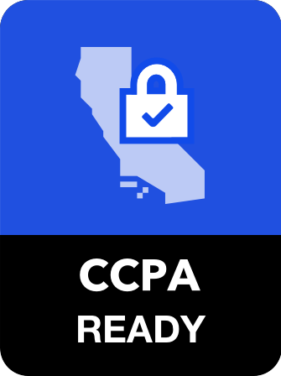
Auditrunner Data Protection Compliance Suite
Establish compliance with data protection regulations
Incident
Mgmt
Regulation
Catalog
Information
Assets
Data Inventory
Request
Mgmt
Data
Destruction
Process Catalog

Slide 15



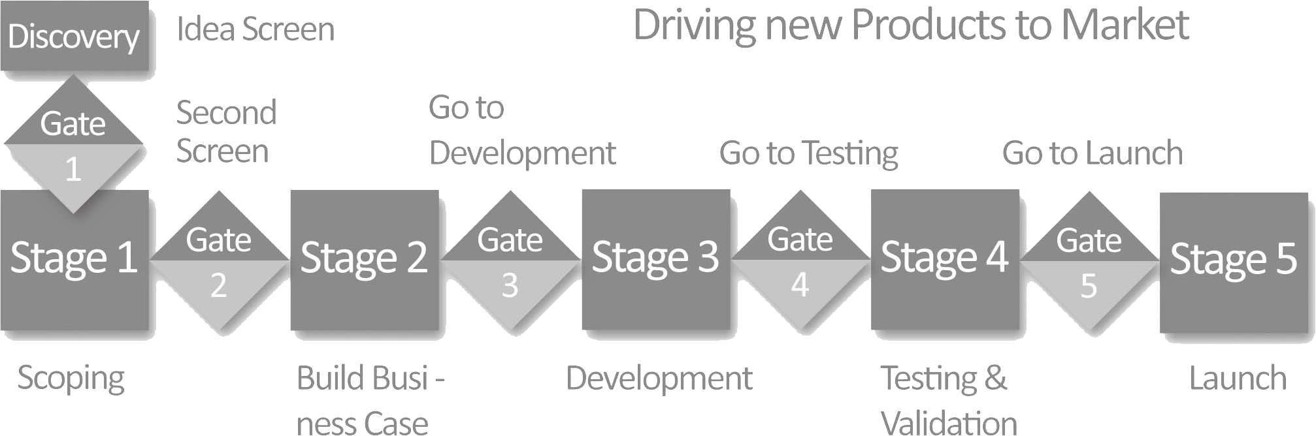
Stagest
Product Lifecycle
Management Platform
Stagest is designed for managing
new product, new brand, new market, current business continuity, renovation or delisting of an existing product, innovation and idea management projects of enterprises.
3000+
product projects handled

Slide 16
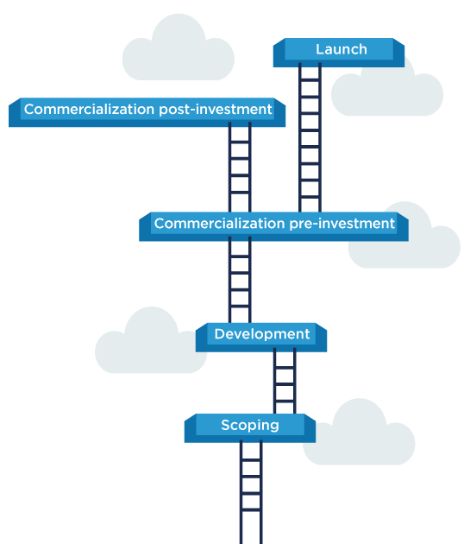
What is
Stage-Gate™?
Stage-Gate is a modular project management methodology, which is widely accepted especially among product development circles.
A Stage-Gate project consists of predetermined and sequential steps, or “stages”. Each stage consists of a set of certain cross-functional and parallel activities which must be successfully completed prior to obtaining management approval to proceed to the next stage.
At the end of each stage, the overall progress is sent for «gate» approval. These «gates», which are normally meetings, control the process and serve as:
Quality control of the completed stage
Go/No-Go check-points
Readiness-checks
Must-Meet and Should-Meet criteria
Marker for action plan for the next stage

Slide 17
Executed with Stagest
Sample Projects
New Product or Brand Innovation
Business Continuity
Creating a new product or brand from scratch
Add new items to an existing product or brand
Spin-off new product or brand from an existing one
Sustainability projects
Market share growth
Market share retention
Marketing Strategy
Market Innovation
Co-packing & bundling
Co-production
Localized production at different locations
Entering a new market
Adapting products for a new market
Delisting
Complete delisting of a product
Partial delisting of a product
Product renovation
Delisting of a brand

Slide 18






Individual Evaluations
Define performance indicators for each employee and evaluate them at the end of each period
WR Perform
Human Resources
Performance Evaluation Platform
Group/Department Evaluations
Define performance indicators for each department and/or group in the organization and evaluate them
at the end of each period
Company Evaluations
Define common performance indicators for the whole company and evaluate them at the end of each period
WR Perform enables you to conduct
important and demanding processes of
Human Resources on a digital platform;
180⁰ & 360⁰ Performance Evaluations.
More practical, less time-consuming, collaborative & easy-to-track.
Competency Evaluations
Define competency classes for each position and evaluate each employee accordingly at the end of each period
Self Evaluations
Get self evaluations from each employee and enable them to evaluate their immediate colleagues/team members

Slide 19

Increased Efficiency
WR OnBoard
Onboarding Management Platform
92%
20x
WR OnBoard helps companies to automate the process of
voluminous new partner, supplier, and client onboarding
on a single and unified digital platform.
20%
18%
Number of Vendors
Time Savings
Resource Savings
Satisfaction Increase
Expand Network
Increase Effectiveness
Expand your partner, agent, supplier, franchise or client network rapidly and efficiently
Increase the level of commitment and satisfaction of your business partners to increase network effectiveness
Save considerable time and money
at your operations

Slide 20
WR OnBoard
Onboarding Process
Evaluation
Portfolio Details
Vendor Account
Applicant’s products and services, are evaluated against pre-determined criteria like credit score and market reputation.
Vendor’s products and services are analyzed and uploaded to be added into the portfolio
All Vendor lifecycle communication, payments and action details are logged centrally.
Application
Registration
Control
Vendor applications are gathered through different channels
such as website and e-mail
Approved Vendor shares documents and information
to create a vendor account.
Vendor’s products and services are evaluated and positioned to
an appropriate setting

Slide 21
Industry Solutions

Slide 22
Workrunner
Industry Solutions
R&D, Marketing, Product Management
Packaging Artwork Management
Product Development Project Mgmt
Innovation Idea Screening
Product Lifecycle Management
R&D Project Management
Government Grants Management
Marketing Project & Strategy Mgmt
Finance
CAPEX Investment Management
OPEX Expenditure Management
Loan Operations & Refinancing
Cash Flow Management
Real Estate & Property Management
Asset Management
Human Resources
eLearning & eTraining
Advance Payments
Trial Run Evaluation
eSurveys, eTests & eCertificates
Duty Forms
Job Descriptions
Expense & Travel Management
Human Resource Management
Sign-on & Orientation
Cease of Employment
Leave Requests
Team Management
Channel Organization Management
Interviews & CV Pool
Organization Structure Management
Performance Evaluations - 180⁰ & 360⁰
Career Management
Personnel Records
Competence & Background Pool
Position Changes
Promotions & Demotions
Nominations & Appointments
Timekeeping
Medical Reports
New Headcount Request
Sales & Channel Management
New Store/Point Feasibility Analysis
Store Opening & Closing Processes
Dealer Advance & Security Payments
Dealer Channel Organization
Customer Relations Management
Distribution Channel Organization
Order Input & Tracking
Services & Project Sales
Distant Sales
Customer Service – Ticketing
Technical Service – Ticketing
Supplier Management
Sales Support
Periodic Discounts & Special Offers
Insurance, Life & Pension
Intermediary Advance & Security Payments
Actuary Period Closure
Individual Insurance Policy Management
Individual Pension Policy Management
Group Pension Policy Management
Policy Support
Document Quality Control
Operational & Transactional Processes
Collection & Reconciliation
Cancelation & Abandonment
Damage Evaluation & Payments
Risk Evaluation & Underwriting
Banking
Fund Transfer Management
Receipt Cancellation
Group Transfers
Card & POS Operations
Loan Application & Approval
Customer Visit Planning & Pricing
Production & Resource Management
Packaging Artwork Management
Warehouse Management & Transfer
Raw & Intermediate Material Tracking
Scale & Laboratory Data Input
Goods Acceptance
Shipment Management & Waybills
Stock & Inventory Management
Supplier Management
Production Planning & Tracking
Product Label Management
Operations
Asset & Inventory Management
Document Editor & Manager
Electronic Signature
Incoming/Outgoing Document & Parcel Management
Electronic Invoice
Incoming Invoice Approval & Recognition
Outgoing Invoice Approval & Issuance
Request Management (Ticketing)
Project Management
Procurement
Contract Management & Tracking
Stock & Inventory Management
Meeting Management & Task Tracking
Liability Management
Information Technologies
IT Project Management
IT Procurement
IT Request Management (Ticketing)
Application Access Control Rights Mgmt
File Transfer API
Batch & Singular Electronic Signing
Education
Teacher/Trainer Assignment
Curriculum Management
Catering
Catering Special Product Management
Catering Procurement

Slide 23
Thanks.
Questions?

Slide 24

Get in
touch
Contact Information
4048 Lick Mill Blvd, Santa Clara, CA
+1 650 206 2368
Workrunner
sales@workrunner.io
The Low-code Application Development Platform
www.workrunner.io
Visit Us

